Slide 1
Combining Formulas
WARM-UP
Most bullets can be described as a hemisphere (half sphere) on top of a cylinder. Using the measurements provided on the diagram, find the volume of gunpowder that is needed to fill the bullet?
3 cm
1.5 cm

Slide 2
Solving Systems of Linear Equations by Graphing
Essential Question?
How can you solve a system of equations by graphing?
8.EE.8a

Slide 3
Common Core Standard:
8.EE.8 ─ Analyze and solve pairs of simultaneous linear equations.
a. Understand that solutions to a system of two linear equations in two variables correspond to points of intersection of their graphs, because points of intersection satisfy both equations simultaneously.

Slide 4
Objectives:
To solve a system of linear equations by graphing and recognize the solution as the point of intersection.
To interpret the solution of a linear system.

Slide 5
Curriculum Vocabulary
System of Equations (sistema de ecuaciones):
A set of two or more equations that contain two or more variables.
Solution of a System of Equations
(solución de un sistema de ecuaciones):
A set of values that make all equations in a system true.

Slide 6
The Solution to a Linear System
The solution of a linear system is
THE POINT OF INTERSECTION of the two lines.
The solution of a linear system is also called
THE BREAK EVEN POINT

Slide 7
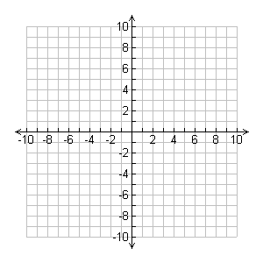
Example:
THE BREAK EVEN POINT

Slide 8
The Solution to a Linear System
The solution of a linear system is
written as an ORDERED PAIR (x, y)
If an ordered pair is a solution,
1) it makes both equations true.
2) it will be the point of intersection.

Slide 9
Three Possibilities for a Linear System
The lines intersect
ONE SOLUTION
written as an ordered pair (x, y)
The lines are parallel (never intersect)
NO SOLUTION
The lines are the same/identical (overlap/coincide)
INFINITE SOLUTIONS

Slide 10
Solving A System by Graphing
Step 1: Graph both lines (either create a table of values or rewrite equations in slope-intercept form)
Step 2: Determine the point of intersection
Step 3: Write the solution as an ordered pair or as a complete sentence for a word problem

Slide 11
Solving A System by Graphing
Solve the following system of equations by graphing:
$$\left\{\begin{aligned}x+2y=6 \\ x−y=3\end{aligned}\right.$$

Slide 12
Example:

Slide 13
Example:

Slide 14
Example:

Slide 15
Example:

Slide 16
Example:

Slide 17
Example:

Slide 18
ACCURACY
Using a graph to determine the solution of a linear system gives us an
ESTIMATE
We need a more accurate way of determining a solution when the graphs don’t match perfectly with the grid lines

Slide 19
METHODS
Graphing (only gives an ESTIMATE)
Substitution
Elimination (also called linear combinations)

