Slide 1
The Pythagorean Theorem
Essential Question?
How can you prove the Pythagorean Theorem and use it to solve problems?
8.G.6, 8.G.7, 8.G.8

Slide 2
Common Core Standard:
8.G ─ Understand and apply the Pythagorean Theorem.
6. Explain a proof of the Pythagorean Theorem and its converse.
7. Apply the Pythagorean Theorem to determine unknown side lengths in right triangles in real-world and mathematical problems in two and three dimensions.
8. Apply the Pythagorean Theorem to find the distance between two points in a coordinate system.

Slide 3
Objectives:
To prove and use the Pythagorean Theorem.

Slide 4
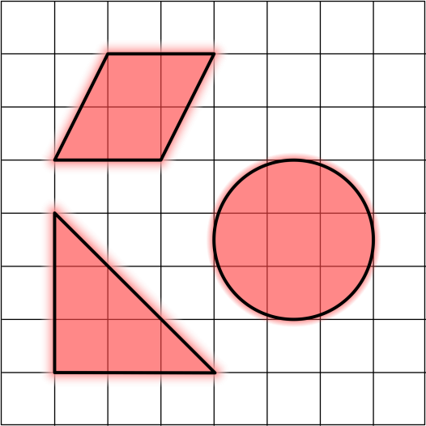
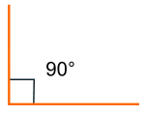
Curriculum Vocabulary
Area (área):
The number of square units needed to cover a given surface.
Right Angle (ángulo recto):
An angle that measures 90˚.
Right Triangle (triángulo recto):
A triangle containing a right angle.
Square Root (raíz cuadrado):
$$\sqrt{5}≈2.236$$
A number that is multiplied by itself to form a product is called a square root of that product.

Slide 5
Curriculum Vocabulary
Hypotenuse (hipotenusa):
In a right triangle, the side opposite the right angle. It will always be the longest side of a right triangle.
HYPOTENUSE
LEG
LEG
LEG
LEG
Legs (catetos):
In a right triangle, the sides that are adjacent to the right angle. In an isosceles triangle, the pair of congruent sides.
Theorem (teorema):
A mathematical statement that has been proven true through the use of definitions, axioms, and other proven theorems.

Slide 6
Curriculum Vocabulary
Diagonal of a rectangle or square :
A diagonal of a rectangle/square is a line segment connecting opposite vertices of the rectangle/square.

Slide 7
The Pythagorean Theorem
In a RIGHT TRIANGLE, the two sides that form the right angle are the LEGS.
The side opposite the right angle is the HYPOTENUSE.
HYPOTENUSE
LEG
LEG

Slide 8
The Pythagorean Theorem
The PYTHAGOREAN THEOREM states that in a right triangle, the sum of the squares of the lengths of the legs is equal to the square of the length of the hypotenuse.
If $a$ and $b$ are legs and $c$ is the hypotenuse, then
$$a^{2}+b^{2}=c^{2}$$
$$c$$
$$a$$
$$b$$

Slide 9
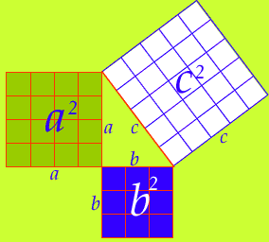
The Pythagorean Theorem
$$a^{2}+b^{2}=c^{2}$$

Slide 10
The Pythagorean Theorem
$$a^{2}+b^{2}=c^{2}$$

Slide 11
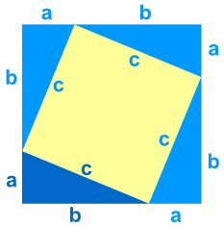
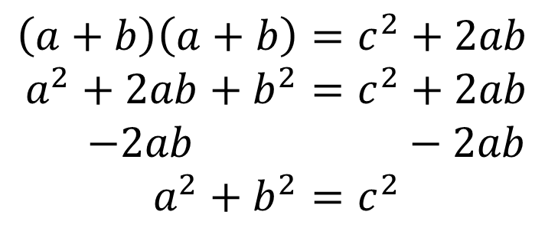
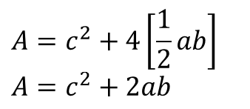
Proof of the Pythagorean Theorem
$$A=c^{2}+4\left[\frac{1}{2}ab\right]$$
$$A=c^{2}+2ab$$
$$A={\left(a+b\right)}^{2}$$
$$A=\left(a+b\right)\left(a+b\right)$$
$$\left(a+b\right)\left(a+b\right)=c^{2}+2ab$$
$a^{2}+2ab+b^{2}=c^{2}+2ab$
$$−2ab −2ab$$
$a^{2}+b^{2}=c^{2}$

Slide 12
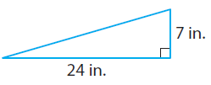
Using the Pythagorean Theorem
Find the length of the missing side:
STEP 1:
Write the Pythagorean Theorem
$$a^{2}+b^{2}=c^{2}$$
STEP 2:
Identify $a$, $b$, and $c$
$$a=7 b=24 c=?$$
STEP 3:
Substitute and solve for the missing variable
$$7^{2}+{24}^{2}=c^{2}$$
$$49+576=c^{2}$$
$$625=c^{2}$$
$$\sqrt{625}=\sqrt{c^{2}}$$
$$25=c$$
The length of the hypotenuse is 25 inches.

Slide 13
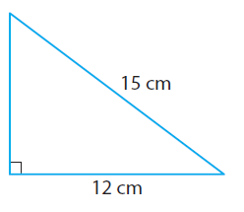
Using the Pythagorean Theorem
Find the length of the missing side:
STEP 1: Write the Pythagorean Theorem
$$a^{2}+b^{2}=c^{2}$$
STEP 2: Identify $a$, $b$, and $c$
$$a=? b=12 c=15$$
STEP 3: Substitute and solve for the missing variable
$$a^{2}+{12}^{2}={15}^{2}$$
$$a^{2}+144=225$$
$−144 −144$
$$a^{2}=81$$
$$\sqrt{a^{2}}=\sqrt{81}$$
$$a=9$$
The length of the leg is 9 centimeters.

Slide 14
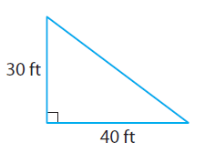
Using the Pythagorean Theorem
Find the length of the missing side:

Slide 15
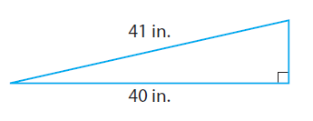
Using the Pythagorean Theorem
Find the length of the missing side:

Slide 16
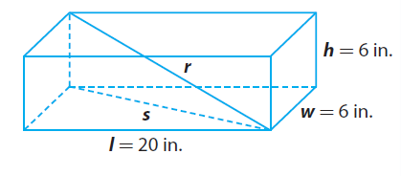
Pythagorean Theorem in Three Dimensions
A box used for shipping narrow copper tubes measures 6 inches by 6 inches by 20 inches. What is the length of the longest tube that will fit in the box, given that the length of the tube must be a whole number of inches?
STEP 1: You want to find r, the length from a bottom corner to the opposite top corner.
First find s, the length of the diagonal across the bottom of the box.
$$w^{2}+l^{2}=s^{2}$$
$$6^{2}+{20}^{2}=s^{2}$$
$$36+400=s^{2}$$
$$436=s^{2}$$

Slide 17
Pythagorean Theorem in Three Dimensions
A box used for shipping narrow copper tubes measures 6 inches by 6 inches by 20 inches. What is the length of the longest tube that will fit in the box, given that the length of the tube must be a whole number of inches?
STEP 2: Use $s^{2}$ to find r.
$$s^{2}+h^{2}=r^{2}$$
$$436+6^{2}=r^{2}$$
$$436+36=r^{2}$$
$$472=r^{2}$$
$$\sqrt{472}=\sqrt{r^{2}}$$
$$21.7≈r$$
The length of the longest tube that will fit in the box is 21 inches.

Slide 18
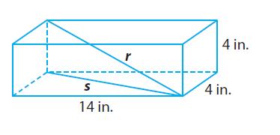
Pythagorean Theorem in Three Dimensions
Tina ordered a replacement part for her desk. It was shipped in a box that measures 4” X 4” X 14”. What is the greatest length in whole inches that the part could have been?

Slide 19
Pythagorean Theorem in Three Dimensions
Tina ordered a replacement part for her desk. It was shipped in a box that measures 3 X 5 X 11. What is the greatest length in whole inches that the part could have been?
3 ft
5 ft
11 ft

