Slide 1
WARM UP:
Is the dilation an enlargement or reduction?
How do you know?
Where is the center of dilation (approximately)?
What is the scale factor?
A
B
C
D
A´
B´
C´
D´

Slide 2
Properties of Dilations
Essential Question?
How can you describe the effect of a dilation on coordinates using an algebraic representation?
8.G.3

Slide 3
Common Core Standard:
8.G ─Understand congruence and similarity using physical models, transparencies, or geometry software.
3. Describe the effect of dilations, translations, rotations, and reflections on two-dimensional figures using coordinates.

Slide 4
Objectives:
Describe the effect of dilation on two-dimensional figures using coordinates.

Slide 5
Properties of Dilations
In the last lesson we learned that
Dilations change the size (but not the shape) of a figure.
orientation is preserved.
Every dilation has a fixed point called the
CENTER OF DILATION
located where the lines connecting corresponding parts of figures intersect.

Slide 6
Properties of Dilations
Think of what we learned in the last lesson about
SCALE FACTOR
Think about the word FACTOR …
The word FACTOR implies
MULTIPLICATION
Since DILATIONS have a scale factor, each of their coordinates gets
MULTIPLIED
by the scale factor.
We can represent this using algebraic notation:
$$\left(x,y\right) →(kx, ky)$$
THIS is true ONLY if the CENTER of DILATION is the ORIGIN

Slide 7
Properties of Dilations
$$\left(x,y\right) →(kx, ky)$$
If the dilation is an enlargement, the scale factor is
GREATER THAN 1
$$k>1$$
If the dilation is a reduction, the scale factor is
BETWEEN 0 and 1
$$0<k<1$$
(improper fraction)
(proper fraction)

Slide 8
Center of Dilation
The center of dilation can be inside or outside the image and preimage.
The center of dilation can be anywhere on the coordinate plane as long as the lines that connect each pair of corresponding vertices between the image and preimage intersect at the center of dilation.

Slide 9
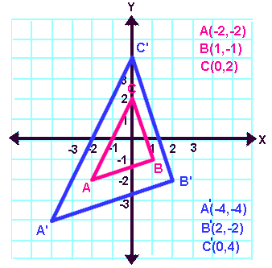
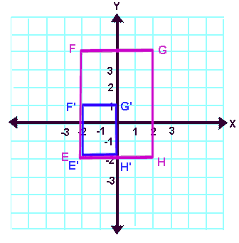
Center of Dilation
INSIDE the image and preimage

Slide 10
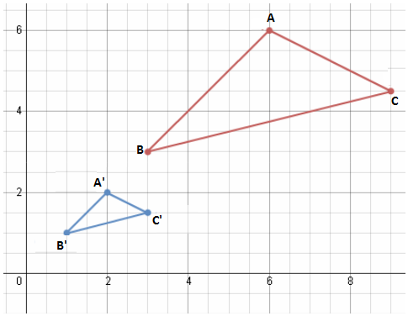
Center of Dilation
OUTSIDE the image and preimage

Slide 11
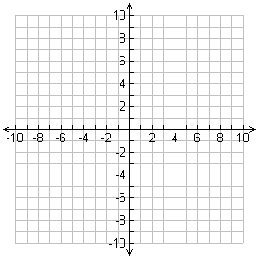
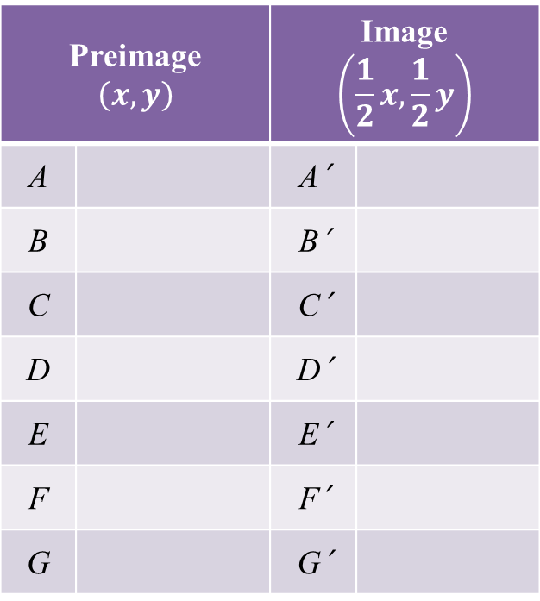
The arrow undergoes a dilation with a scale factor of $\frac{1}{2}$.
The center of dilation is the origin.
Complete the table to find the vertices of the image
Draw the image and label the vertices
Preimage $$\left(x,y\right)$$ |  | Image $$\left(\frac{1}{2}x,\frac{1}{2}y\right)$$
A |  | A´
B |  | B´
C |  | C´
D |  | D´
E |  | E´
F |  | F´
G |  | G´
A
G
B
F
C
E
D

Slide 12
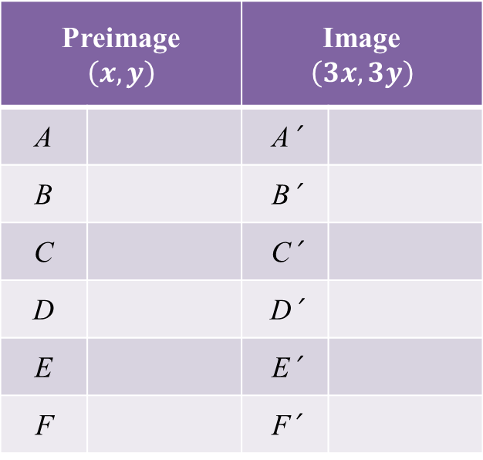
The figure undergoes a dilation with a scale factor of 3.
The center of dilation is the origin.
Complete the table to find the vertices of the image
Draw the image and label the vertices
Preimage $$\left(x,y\right)$$ |  | Image $$\left(3x, 3y\right)$$
A |  | A´
B |  | B´
C |  | C´
D |  | D´
E |  | E´
F |  | F´
A
B
F
C
E
D

