Slide 1
Representing Proportional Relationships
Essential Question?
How can you use tables, graphs, mapping diagrams, and equations to represent proportional situations?
8.EE.6, 8.F.4

Slide 2
Common Core Standard:
8.F.4 ─ Use functions to model relationships between quantities.
Construct a function to model a linear relationship between two quantities. Determine the rate of change and initial value of the function from a description of a relationship or from two (x, y) values, including reading these from a table or from a graph. Interpret the rate of change and initial value of a linear function in terms of the situation it models, and in terms of its graph or a table of values.
8.EE.6 ─ Understand the connections between proportional relationships, lines, and linear equations.
Use similar triangles to explain why the slope m is the same between any two distinct points on a non-vertical line in the coordinate plane; derive the equation y=mx for a line through the origin and the equation y=mx+b for a line intercepting the vertical axis at b.

Slide 3
Objectives:
Understand that a function is a rule that assigns to each input exactly one output.
Identify whether a relationship is a function from a diagram, table of values, graph, or equation.

Slide 4
PROPORTIONAL RELATIONSHIPS
A PROPORTIONAL RELATIONSHIP is a relationship between two quantities in which the ratio of one quantity to the other is CONSTANT.
In this example the change is always $12 earned for every 1 hour worked.
We can set up a fraction:
$\frac{output change}{input change}$ or $\frac{y}{x}$
In this example it would be:
$\frac{12}{1}$ or $12$
Number of Hours Worked | Money Earned
1 | 12
2 | 24
3 | 36
4 | 48
5 | 60
1
12
1
12
1
12
1
12

Slide 5
PROPORTIONAL RELATIONSHIPS
A PROPORTIONAL RELATIONSHIP can be described by an equation in the form $y=kx$, where $k$ is a number called the CONSTANT OF PROPORTIONALITY.
If $y=kx$, then $k=\frac{y}{x}$
In our example the constant of proportionality, k, is $\frac{12}{1}$ or 12 .
The equation would be:
$y=\frac{12}{1}x or y=12x$
Number of Hours Worked | Money Earned
1 | 12
2 | 24
3 | 36
4 | 48
5 | 60
1
12
1
12
1
12
1
12

Slide 6
PROPORTIONAL RELATIONSHIPS
It is important to note that all PROPORTIONAL RELATIONSHIPS MUST contain the ordered pair (0,0) [the origin] as part of the table.
If (0,0) does not appear, you may need to EXTEND THE TABLE to determine if the function is proportional.
Example: Does the table represent a proportional relationship?
Is there a constant rate of change?
Do you see (0,0) on the table?
Input | 2 | 4 | 6 | 8 | 10
Output | 5 | 10 | 15 | 20 | 25

Slide 7
PROPORTIONAL RELATIONSHIPS
There are always THREE (3) things to test for a proportional relationship:
Is it a FUNCTION?
Is it LINEAR?
Does (0, 0) appear on the table?
All THREE must be true.

Slide 8
PROPORTIONAL RELATIONSHIPS
Let’s see if there is a constant rate of change.
-2
-2
-2
-2
Input | 2 | 4 | 6 | 8 | 10
Output | 5 | 10 | 15 | 20 | 25
-5
-5
-5
-5
We see that for each time the output decreases by 5, the input decreases by 2.
There IS a constant rate of change!

Slide 9
PROPORTIONAL RELATIONSHIPS
Let’s extend the table to see if (0,0) is part of the table.
Input | 2 | 4 | 6 | 8 | 10
Output | 5 | 10 | 15 | 20 | 25
-2
-2
-2
-2
-2
0
Input |  | 2 | 4 | 6 | 8 | 10
Output |  | 5 | 10 | 15 | 20 | 25
0
-5
-5
-5
-5
-5
Now we see that (0,0) is part of the table.
Since there is a constant rate of change and (0,0) is part of the table, this IS PROPORTIONAL.
We can write the equation as $y=\frac{−5}{−2}x$ or $y=\frac{5}{2}x$

Slide 10
PROPORTIONAL RELATIONSHIPS
Does this table represent a proportional relationship?
Input | 1 | 2 | 3 | 4 | 5
Output | 1 | 4 | 9 | 16 | 25
Is there a constant rate of change?
NO
This is NOT a proportional relationship.

Slide 11
PROPORTIONAL RELATIONSHIPS
Does this table represent a proportional relationship?
Input | 1 | 2 | 3 | 4 | 5
Output | 15 | 20 | 25 | 30 | 35
Is there a constant rate of change?
YES
If you extend the table, will (0,0) be part of it?
NO
This is NOT a proportional relationship.

Slide 12
PROPORTIONAL RELATIONSHIPS
Is there a faster way to determine if a relationship is proportional?
Recall:
A PROPORTION is a mathematical statement showing two ratios (fractions) are equal.
We can test proportionality by
CROSS MULTIPLYING
x | ─ 2 | 4 | 6 | ─ 6 | ─ 10
Y | 3 | ─ 6 | ─ 9 | 9 | 15

Slide 13
PROPORTIONAL RELATIONSHIPS
Let’s test:
+12
+12
+54
+54
x | ─ 2 | 4 | 6 | ─ 6 | ─ 10
Y | 3 | ─ 6 | ─ 9 | 9 | 15
─ 36
─ 36
─ 90
─ 90
Since each set of ordered pairs was PROPORTIONAL, we can say that this table represents a
PROPORTIONAL RELATIONSHIP.
This automatically implies:
The table represents a FUNCTION.
The table shows a constant rate of change, so it is LINEAR.
If we extend the table, the ordered pair (0, 0) will appear.

Slide 14
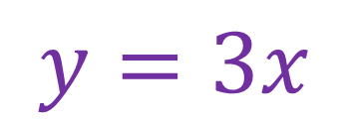
PROPORTIONAL RELATIONSHIPS
So far we have seen a proportional relationship represented as:
A TABLE • An EQUATION
Input | Output
0 | 0
1 | 3
2 | 6
3 | 9
4 | 12
5 | 15
$$y=3x$$

Slide 15
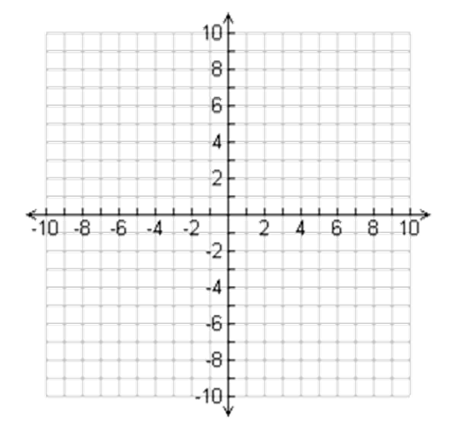
PROPORTIONAL RELATIONSHIPS
Another way to represent a proportional relationship is as
A GRAPH
The best way to graph a relationship is to use the table.
Create ordered pairs and plot them.
Input | Output
0 | 0
1 | 3
2 | 6
3 | 9
4 | 12
(0,0)
(1,3)
(2,6)
(3,9)
(4,12)

Slide 16
REPRESENTING FUNCTIONS
Since we know there is a CONSTANT RATE OF CHANGE, we can connect the dots with a STRAIGHT LINE.

Slide 17
PROPORTIONAL RELATIONSHIPS
Let’s examine the graph of a proportional relationship and a non-proportional relationship and see if we can draw a conclusion.
PROPORTIONAL RELATIONSHIP
NON-PROPORTIONAL RELATIONSHIP
Input | Output
1 | 3
2 | 6
3 | 9
4 | 12
5 | 15
Input | Output
1 | 2
2 | 3
3 | 4
4 | 5
5 | 6
What is the main difference between the two graphs?
The graph of a PROPORTIONAL RELATIONSHIP
is a LINE that PASSES THROUGH THE ORIGIN!

Slide 18
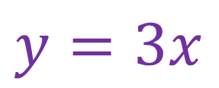
PROPORTIONAL RELATIONSHIPS
We have now seen a PROPORTIONAL RELATIONSHIP represented as:
A TABLE
CONSTANT rate of change
CONTAINS the ordered pair (0,0)
An EQUATION
Takes the form $y=kx$ where $k$ is the constant of proportionality
A GRAPH
A LINE that passes through the ORIGIN
Input | Output
0 | 0
1 | 3
2 | 6
3 | 9
4 | 12
5 | 15
$$y=3x$$

Slide 19
PROPORTIONAL RELATIONSHIP?
Input | 2 | 3 | 6 | 10
Output | 4 | 5 | 8 | 12

Slide 20
PROPORTIONAL RELATIONSHIP?
Input | 1 | 3 | 5 | 7
Output | 3 | 5 | 7 | 9

Slide 21
PROPORTIONAL RELATIONSHIP?
Input | 4 | 10 | 12 | 13
Output | 8 | 20 | 24 | 26

Slide 22
PROPORTIONAL RELATIONSHIP?
Input | 5 | 7 | 8 | 11
Output | -20 | -28 | -32 | -44

Slide 23
PROPORTIONAL RELATIONSHIP?
Input | 1 | 3 | 6 | 10
Output | 0.5 | 1.5 | 3 | 5

