Slide 1
Determining the Best Measure of Center

Slide 2
Objectives:
To calculate and interpret the mean and median of a data set
To estimate the mean and median of a data set from its data distribution
To determine which measure of central tendency (mean or median) is best to use for a data set

Slide 3
Previously you analyzed a data set by creating a graphical representation of the data. However, you can also analyze a data set by describing numerical characteristics, or STATISTIC, of the data. A statistic that describes the “center” of a data set is called a measure of central tendency. A MEASURE OF CENTRAL TENDENCY is the numerical values used to describe the overall clustering of data in a set. Two measures of central tendency that are typically used to describe a set of data are the mean and the median.
The arithmetic mean, or mean, represents the sum of the data values divided by the number of values. A common notation for the mean is $\overline{x}$, which is read “$x$ bar.”
The formula shown represents the mean of a data set:
$$\overline{x}=\frac{\sum{x}}{n}$$
the sum of the data values
$$\text{mean}$$
the number of data values

Slide 4
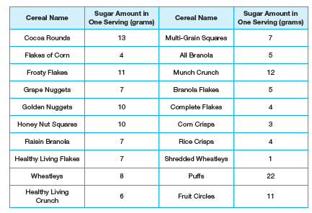
Use the table on page 471 to complete Question 1:
1. Represent the sugar amount in different cereals using the formula for the mean. Then determine the mean of the data set.

Slide 5
How would we use DESMOS to help?
2. For each given symbol, state what it represents and its calculated value.
$\overline{x}$
$Σx$
$n$

Slide 6
Now answer question 4 on page 472:
4. Determine the median sugar amount in grams in one serving of cereal. Interpret the meaning in terms of this problem situation.
How would we use DESMOS to help?
Now look at question 5 on page 473.
Locate and label the mean and median values.
Now answer question 6. Which measure best represents the data set?

Slide 7
Many graphing calculators will create a box-and-whisker plot for you. Unfortunately DESMOS is not a great resource for constructing a box-and-whisker plot. I recommend using the following websites in conjunction with each other:
http://www.shodor.org/interactivate/activities/BoxPlot/
to enter the data and obtain min, max, median, Q1, and Q3
followed by
http://www.imathas.com/stattools/boxplot.html
to create a clean graph
Use these websites to create the box-and whisker plot for the sugar in breakfast cereal data from the table on page 471.
How does it compare to the graph given in question 5?

Slide 8
Now use these websites to complete Question 7 on Pages 473 & 474:
Let’s consider the data set without the value of 22.
Remove the value of 22 from the data set. Use your graphing calculator to create a box-and-whisker plot for the new data set.
Plot above the given box-and-whisker plot your new box-and-whisker plot on the same graph in Question 5.
How does the removal of the value 22 affect the distribution of the data set?
Did the mean and median change with the removal of the value 22? Does your choice for the best measure of center from Question 6 still hold true?

Slide 9
Let’s review the homework from Pages 474 – 476, PROBLEM 2:
When the distribution of data is approximately symmetric, the mean is generally the more appropriate measure of center to use.
When the distribution of data is skewed left or skewed right, the median is the more appropriate measure of center to use.
The reason why the mean is more appropriate in a symmetric data distribution is due to the fact that most data points are close to the mean. There are not many if any data values that are much greater or lesser than the mean.
In a skewed left or right distribution, most data values are closer to the median with few data points being much greater or lesser than the median. Therefore, the median is not affected by these values.

Slide 10
To create a histogram, I recommend the following website:
http://www.shodor.org/interactivate/activities/Histogram/
Use this website to create a histogram for the sugar amounts in one serving of cereal, from the table on page 471. Use an interval size of 4 and minimums of zero for the x- and y- axes.

