Slide 1
Properties of Reflections
Essential Question?
How do you describe the properties of reflection and their effect on the congruence and orientation of figures?
8.G.1, 8.G.3

Slide 2
Common Core Standard:
8.G ─Understand congruence and similarity using physical models, transparencies, or geometry software.
1. Verify experimentally the properties of rotations, reflections, and translations:
a. Lines are taken to lines, and line segments to line segments of the same length.
b. Angles are taken to angles of the same measure.
c. Parallel lines are taken to parallel lines.
3. Describe the effect of dilations, translations, rotations, and reflections on two-dimensional figures using coordinates.

Slide 3
Objectives:
To describe the properties of reflection and their effect on the congruence and orientation of figures.

Slide 4
Properties of Reflection
A REFLECTION is a TRANSFORMATION that flips a figure across a line.
The line is called the LINE OF REFLECTION.
Each point and its image are the same distance from the line of reflection.
REMEMBER: When a point experiences a transformation, the resulting point is called PRIME. The symbol for prime is ´. i.e. point A becomes A´.

Slide 5
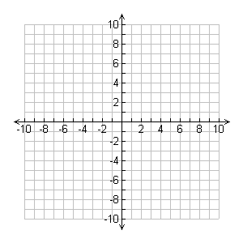
Triangle ABC (△ABC), shown on the coordinate plane, is the PREIMAGE (input).
We will explore reflections across horizontal & vertical lines.
First we will reflect the triangle across the x-axis.
A
△ABC (PREIMAGE)
C
B

Slide 6
First we will reflect the triangle across the x-axis.
Think about what happens to your face when it is reflected in a mirror.
Things that are closer to the mirror in real life are closer in the reflection.
Things that are far away from the mirror appear far away in the reflection.
A
△ABC (PREIMAGE)
C
B

Slide 7
Let us now make the x-axis our “mirror”.
Since the triangle is above the x-axis, when we reflect it, it will appear below the x-axis.
How many units above the x-axis is point B?
Where will B´ appear?
A
△ABC (PREIMAGE)
C
B
2 units above
2 units below
B´

Slide 8
How many units above the x-axis is point C?
Where will C´ appear?
What about point A? Where will A´ appear?
Our image is now △A´B´C´
A
△ABC (PREIMAGE)
6 units above
C
B
2 units above
2 units below
C´
6 units below
B´
A´

Slide 9
Let us now make the y-axis our “mirror”.
Since the triangle is to the right of the y-axis, when we reflect it, it will appear to the left of the y-axis.
How many units to the right of the y-axis is point B?
Where will B´ appear?
A
△ABC (PREIMAGE)
C
B
B´

Slide 10
How many units to the right of the y-axis is point C?
Where will C´ appear?
What about point A? Where will A´ appear?
Our image is now △A´B´C´
A´
A
C´
C
B
B´

Slide 11
REFLECTIONS
What changed when we reflected △ABC?
The ORIENTATION of an image changes after a reflection.

Slide 12
What are the coordinates for T´, R´, A´, and P´?
T´ (2, − 1)
R´ (8, − 1 )
A´ (7, 3)
P´ (3, 3)
How many units is the length
of $\overline{RT}$ ? of $\overline{R´T´}$ ?
of $\overline{PA}$ ? of $\overline{P´A´}$ ?
Do you think the same is true for
$\overline{AR}$ ? and $\overline{A´R´}$ ?
$\overline{PT}$ ? and $\overline{P´T´}$ ?
What can you say about the lengths of the corresponding sides of the image and preimage?
Now let us examine trapezoid TRAP?
Reflect trapezoid TRAP across the x-axis .
Label the vertices of the image T´, R´, A´, and P´.
P´
A´
T
R
T´
R´
P
A

Slide 13
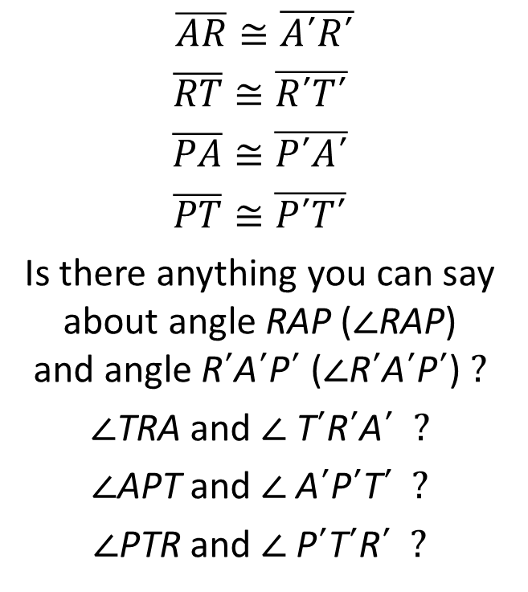
The measures of the corresponding sides of the image and preimage
are equal.
When measurements of line segments are equal, the word we use is
CONGRUENT
$\overline{AR}≅\overline{A´R´}$
$$\overline{RT}≅\overline{R´T´}$$
$$\overline{PA}≅\overline{P´A´}$$
$$\overline{PT}≅\overline{P´T´}$$
Is there anything you can say about angle RAP (∠RAP) and angle R´A´P´ (∠R´A´P´) ?
∠TRA and ∠ T´R´A´ ?
∠APT and ∠ A´P´T´ ?
∠PTR and ∠ P´T´R´ ?
P´
A´
T
R
T´
R´
P
A

Slide 14
The measures of the corresponding angles of the image and preimage
are equal.
When measurements of angles are equal, the word we use is
CONGRUENT
∠RAP ≅ ∠R´A´P´
∠TRA ≅ ∠ T´R´A´
∠APT ≅ ∠ A´P´T´
∠PTR ≅ ∠ P´T´R´
P´
A´
T
R
T´
R´
P
A

Slide 15
We now know that ALL corresponding sides of the image and preimage are CONGRUENT.
We also know that ALL corresponding angles of the image and preimage are CONGRUENT.
We can now say that trapezoid TRAP is CONGRUENT to trapezoid T´R´A´P´
TRAP ≅ T´R´A´P´
What do you think we can now say about the image and preimage after a reflections?
P´
A´
T
R
R
T´
R´
P
A

Slide 16
REFLECTIONS
The IMAGE resulting from a REFLECTION is THE EXACT SAME SHAPE & SIZE as the PREIMAGE!
The IMAGE resulting from a REFLECTION is ALWAYS CONGRUENT to the PREIMAGE!
We now know that:
The image resulting from a TRANSLATION or REFLECTION is CONGRUENT to its preimage!!!!
The only thing that changes with a reflection is the
ORIENTATION.

Slide 17
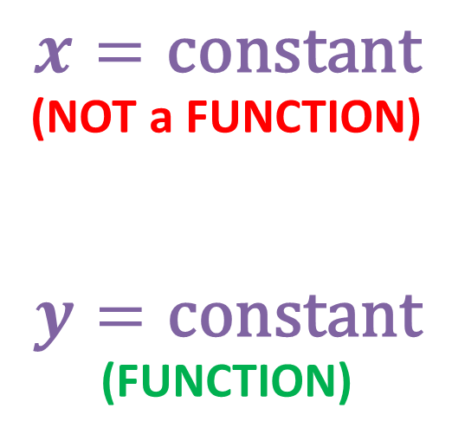
REFLECTIONS ACROSS HORIZONTAL & VERTICAL LINES
$$x=\text{constant}$$
(NOT a FUNCTION)
$$y=\text{constant}$$
(FUNCTION)
⇨ vertical line
⇨ horizontal line

Slide 18
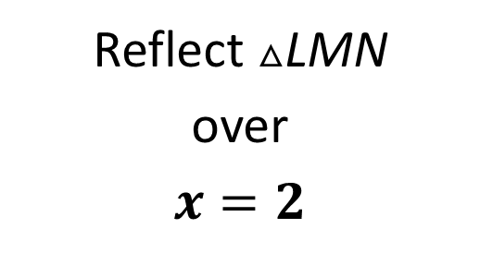
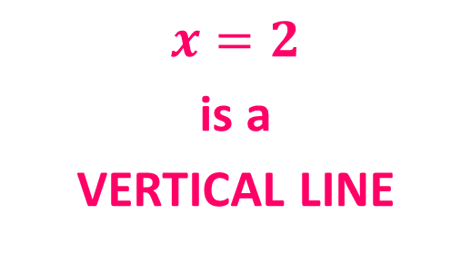
Reflect △LMN
over
$$x=2$$
L´
L
M´
M
N´
N
$$x=2$$
is a
VERTICAL LINE

Slide 19
O
P
S
N
I
Reflect the polygon over the x-axis.
Label the vertices.
Then translate it 2 units right and 4 units up.
Label the vertices.
E
R
T

