Slide 1
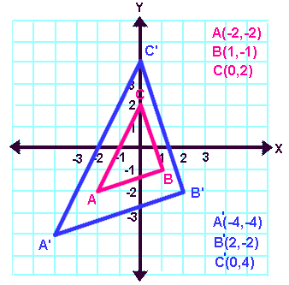
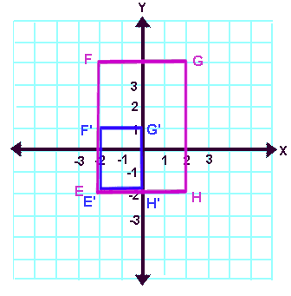
Warm-up:
Find the SCALE FACTOR for each dilation below . You may use any method you wish.
Find the lengths of $\overline{AB}$ and $\overline{A´B´}$

Slide 2
Similar Figures
Essential Question?
What is the connection between transformations and the orientations of similar figures?
8.G.4

Slide 3
Common Core Standard:
8.G ─ Understand congruence and similarity using physical models, transparencies, or geometry software.
4. Understand that a two-dimensional figure is similar to another if the second can be obtained from the first by a sequence of rotations, reflections, translations, and dilations; given two similar two-dimensional figures, describe a sequence that exhibits the similarity between them.

Slide 4
SCALE FACTOR
We already know how to find the scale factor.
What did we use in both our enlargement to find the RATIO?
$$SCALE FACTOR= \frac{image}{preimage}$$
2 methods to determine scale factor:
Compare the corresponding line segments (sides)
Compare the coordinates of corresponding vertices

Slide 5
Objectives:
To describe the connection between transformations and the orientations of similar figures.

Slide 6
Combining Transformations
Animators, such as those at Pixar, move a digital figure by creating a series of transformations:
Translations (moving the figure around)
Rotations (turning the figure around)
Reflections (looking in a mirror)
Dilations (“Honey, I Shrunk the Kids”)
We have already learned that some transformations preserve congruence:
TRANSLATIONS
REFLECTIONS
ROTATIONS

Slide 7
Combining Transformations
DILATIONS do NOT preserve congruence, since the measures of corresponding sides are not equal.
With DILATIONS, the image and preimage are the SAME SHAPE but NOT THE SAME SIZE
When figures have the same shape but not necessarily the same size, the figures are called
SIMILAR
The symbol for “is similar to” is
~
ORIENTATION is preserved with a dilation.

Slide 8
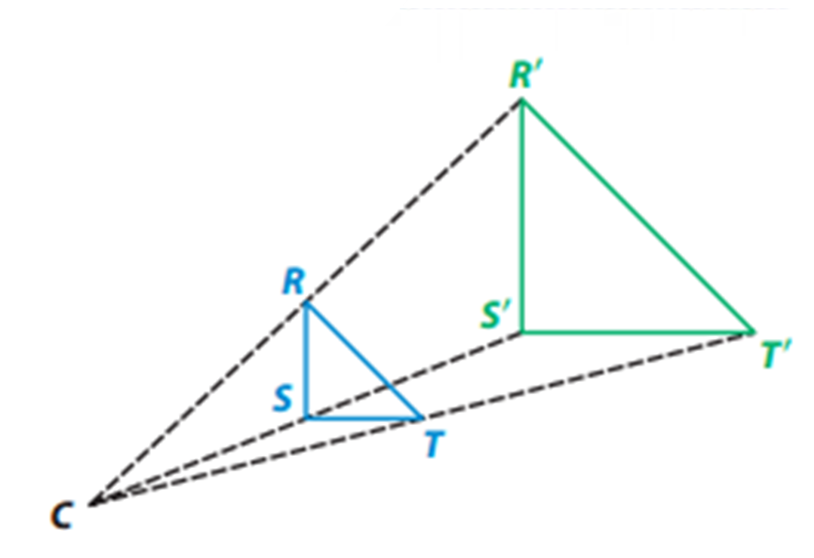
Combining Transformations
In this diagram, the image was formed by a dilation of the preimage.
The two figures have the same shape and orientation, but not the same size.
We can say that the two figures are
SIMILAR
△RST ~ △R´S´T´

Slide 9
SIMILAR FIGURES
Since SIMILAR FIGURES undergo a dilation where a SCALE FACTOR is involved
the lengths of corresponding sides are
IN PROPORTION
Since SCALE FACTOR only affects the measures of line segments
the measures of corresponding angles are
EQUIVALENT

Slide 10
Combining Transformations
SIMILAR FIGURES can be created by a series of transformations
WITH A DILATION
Remember if the only transformations are translations, reflections, and rotations, the figures are
CONGRUENT ^{and} SIMILAR

Slide 11
Similar Figures Activity #1
Apply the indicated sequence of transformations to the rectangle. Each transformation is applied to the image of the previous transformation, not the original figure. Label each image with the letter of the transformation applied.

Slide 13
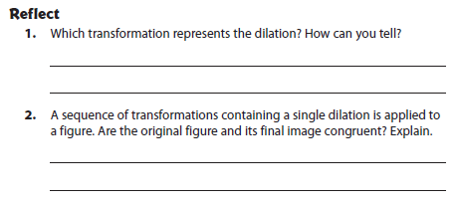

Slide 14
Similar Figures Activity #2

Slide 17
Similar Figures
When you are told that two figures are similar, there MUST be a sequence of transformations
INCLUDING A DILATION
that transforms one into the other.

Slide 18
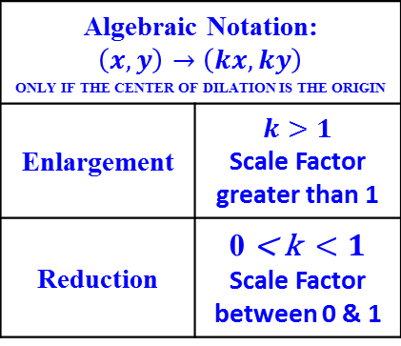
FOLDABLE
NON-ISOMETRIC TRANSFORMATIONS
DILATIONS
(Preserve similarity)
(Orientation preserved)
Algebraic Notation: $$\left(x,y\right)→\left(kx,ky\right)$$ only if the center of dilation is the origin
Enlargement | $$k>1$$ Scale Factor greater than 1
Reduction | $$\text{0} \text{< }\text{k} <1$$ Scale Factor between 0 & 1
SCALE FACTOR: The RATIO used to enlarge or reduce figures.
SIMILAR: Having the same shape, but not necessarily the same size.
Measures of corresponding sides are
IN PROPORTION.
Measures of corresponding angles are
EQUIVALENT.
The symbol for similar is ~ .
The image resulting from a DILATION is SIMILAR to its preimage!

