Slide 1
Exponential Functions
A.SSE.1.a,b
A.CED.1, 2
A.REI.3, 10, 11
F.LE.1, 2, 3, 5
F.BF.1, 2, 3
F.IF.3, 4, 6, 7
N.RN.1, 2
N.Q.2
http://www.cde.ca.gov/be/st/ss/documents/ ccssmathstandardaug2013.pdf

Slide 2
Reflections
Let’s consider the following three exponential functions:
$h\left(x\right)=2^{x}$
$m\left(x\right)=−\left(2^{x}\right)$
$n\left(x\right)=2^{(−x)}$
Let’s work together to complete Pages 328-329:
(use DESMOS to complete #4)
Write the functions $m(x)$ and $n(x)$ in terms of the basic function $h(x)$.
$m(x)=$
$n(x)=$

Slide 3
Reflections

Slide 4
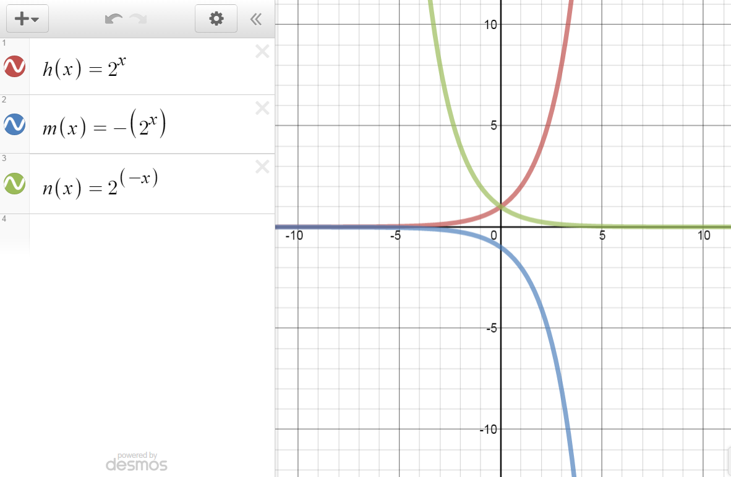
Use DESMOS to complete question 4 on Page 328:

Slide 5
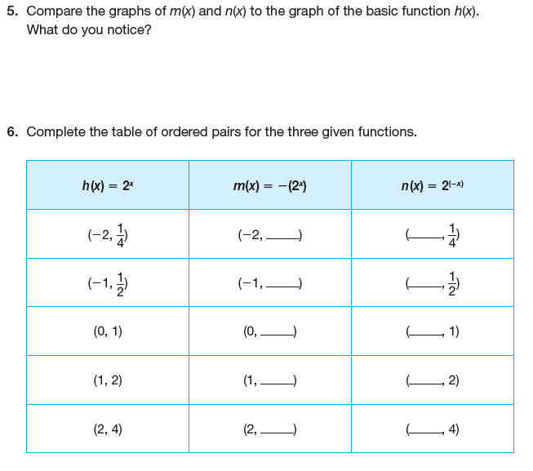

Slide 6
Reflections

Slide 7
Reflections
A REFLECTION of a graph is a mirror image of the graph about a LINE OF REFLECTION.
A LINE OF REFLECTION is the line that the graph is reflected about.
As you may remember from Course 3, a horizontal line of reflection affects the y-coordinates, and a vertical line of reflection affects the x-coordinates.

Slide 8
Reflections
You can use coordinate notation to indicate a reflection about a horizontal line of reflection:
$$\left(x,y\right)\underset{→}{}\left(x,−y\right)$$
You can also use coordinate notation to indicate a reflection about a vertical line of reflection:
$$\left(x,y\right)\underset{→}{}\left(−x,y\right)$$

Slide 9
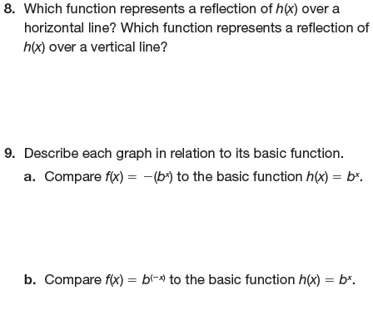
Reflections
Now complete questions 8 and 9 on Page 330:

Slide 10
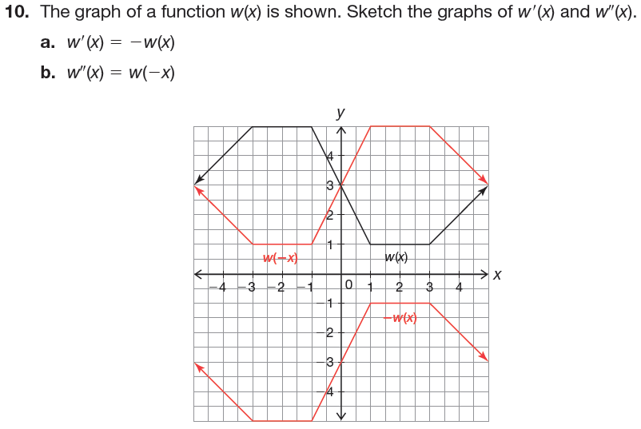
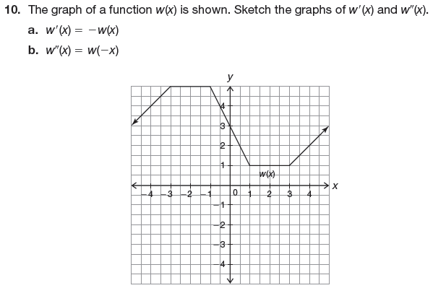
Now complete question 10 on Page 330:

Slide 11
Basic function: $f(x)=2x−3$
What is:
$f(3)$
$f(−5)$
$f(x+1)$
$f(−x)$
$2∙f\left(x\right)$
$−f(x)$

Slide 12
Basic function: $f\left(x\right)=−2x^{4}$
What is:
$f(3)$
$f(−5)$
$f(x+1)$
$f(−x)$
$2∙f\left(x\right)$
$−f(x)$

Slide 13
Basic function: $f\left(x\right)=2x^{−3}$
What is:
$f(3)$
$f(−5)$
$f(x+1)$
$f(−x)$
$2∙f\left(x\right)$
$−f(x)$

Slide 14
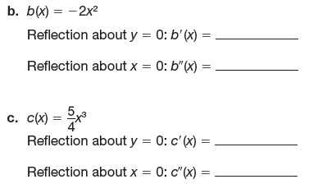
Now complete question 11 on Pages 330 – 331:

Slide 15
Reflections
Now consider the following linear functions:
$g\left(x\right)=x$
$r\left(x\right)=−\left(x\right)$
$s\left(x\right)=\left(−x\right)$
Write the functions $r(x)$ and $s(x)$ in terms of the basic function $g(x)$.
$r(x)=$
$s(x)=$

Slide 16
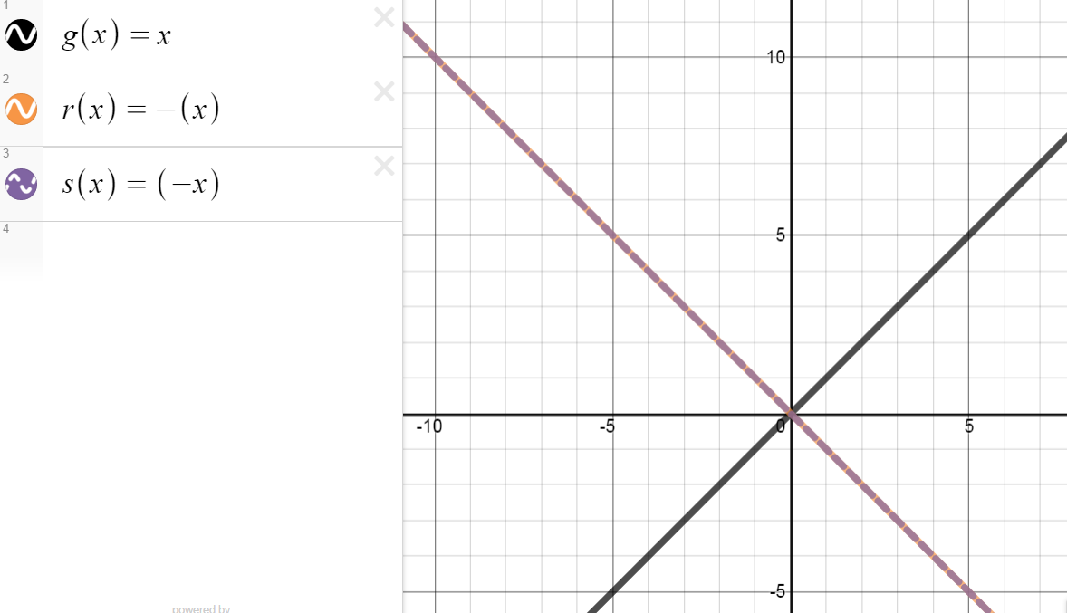
Use DESMOS to complete question 2 on Page 331:

Slide 17
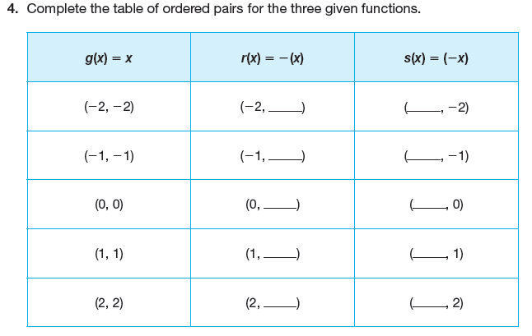
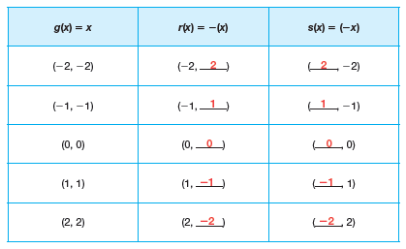
Complete question 3 on Page 331, then complete the table for question 4 on Page 332:

Slide 18
Now complete questions 5 – 6 on Page 332:

Slide 19
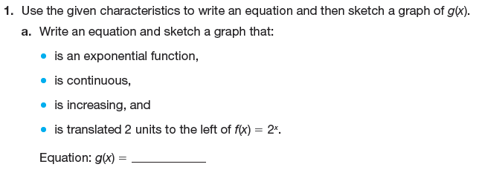
Reflections of Functions
Use DESMOS to graph the function

Slide 20
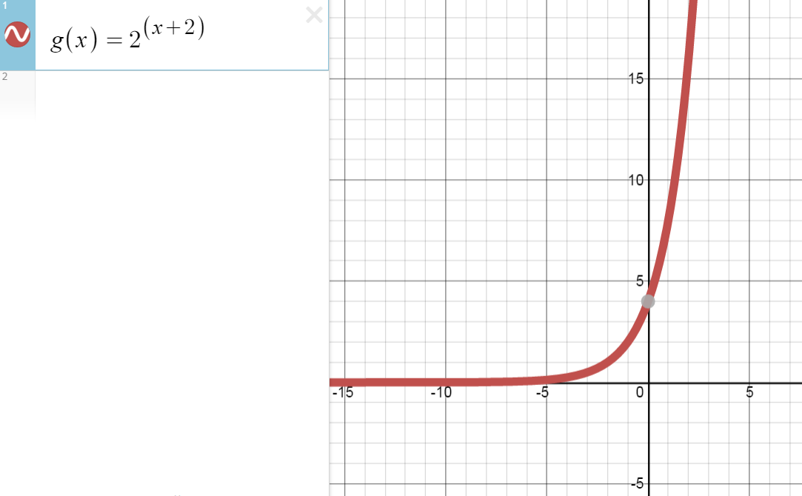

Slide 21
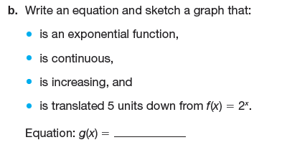
Reflections of Functions
Use DESMOS to graph the function

Slide 22
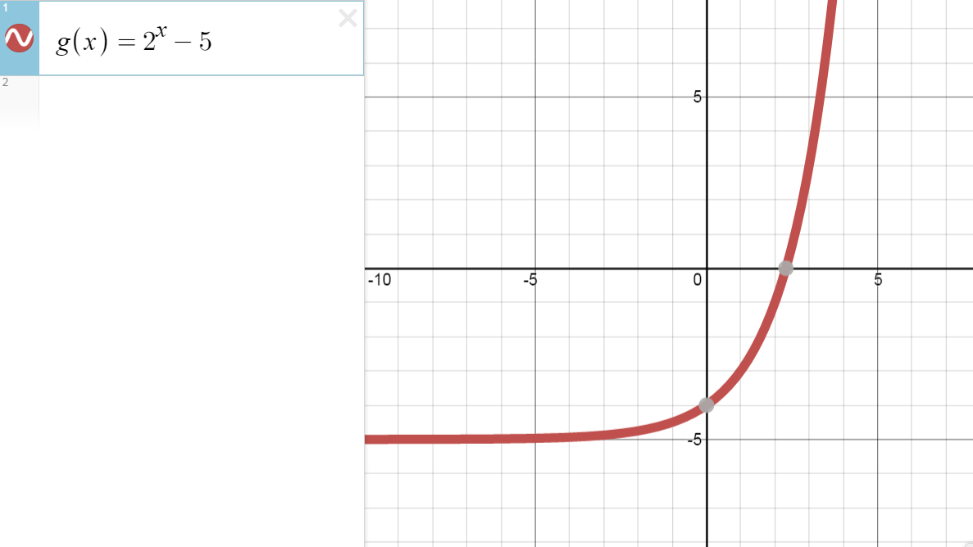

Slide 23
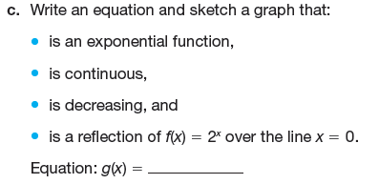
Reflections of Functions
Use DESMOS to graph the function

Slide 24
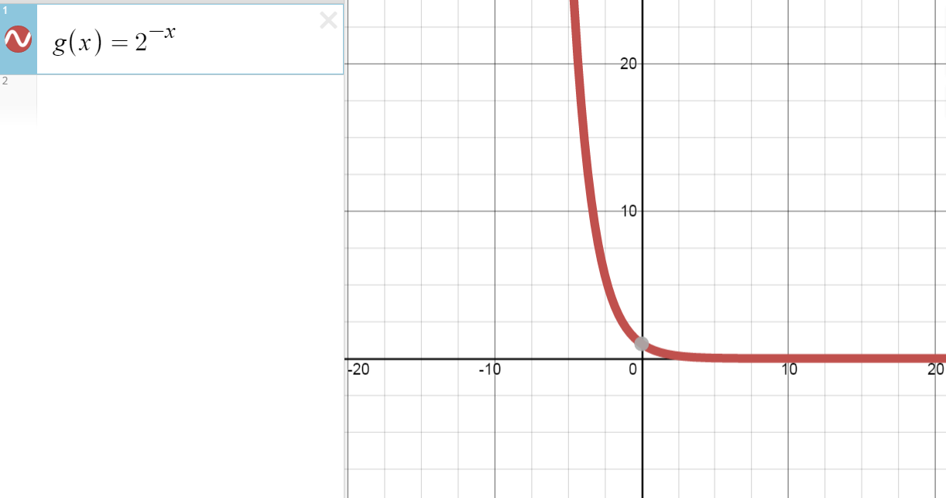

Slide 25
Complete question 2 on Page 334:

Slide 26
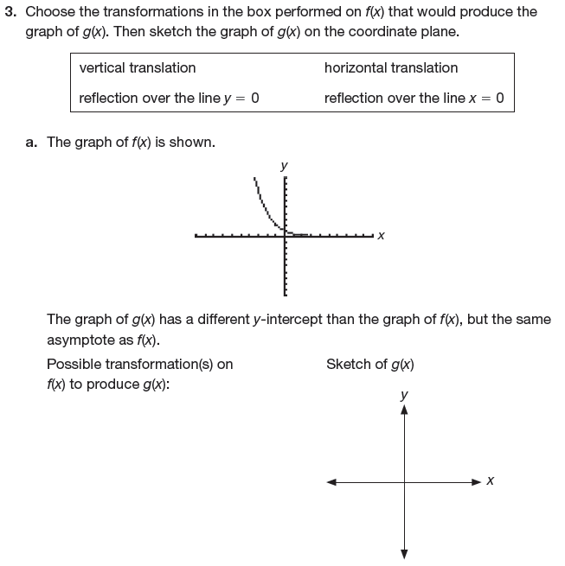
Now complete pages 335 – 336 for homework.

Slide 27
