Slide 1
Using the Slope Formula

Slide 2


Slide 3
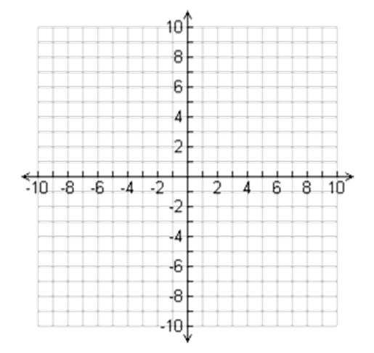
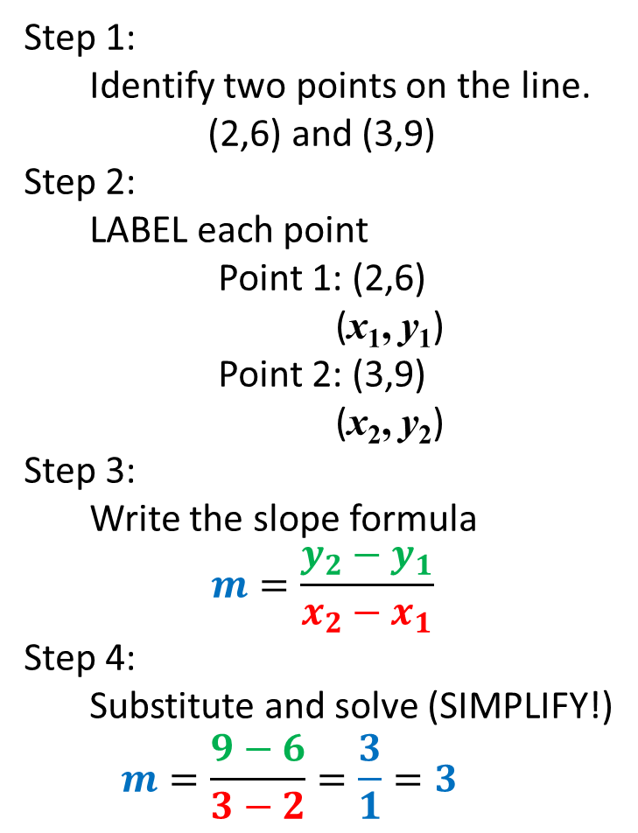
USING THE SLOPE FORMULA
Step 1:
  Identify two points on the line.
(2,6) and (3,9)
Step 2:
  LABEL each point
Point 1: (2,6)
(x₁, y₁)
Point 2: (3,9)
(x₂, y₂)
Step 3:
  Write the slope formula
$$m=\frac{y_{2}−y_{1}}{x_{2}−x_{1}}$$
Step 4:
  Substitute and solve (SIMPLIFY!)
  $$m=\frac{9−6}{3−2}=\frac{3}{1}=3$$

Slide 4
Using Graphs
Find the slope of the line between the two points:

Slide 5
USING TABLES
Find the slope of the line:
Input | Output
1 | 3
4 | 12
5 | 15
Input | Output
7 | ─ 2
15 | ─ 8

Slide 6
JUST TWO POINTS
Find the slope of the line between the two points:
(6,5) and (3,2)
(-7,5) and (2,-4)
(9,-7) and (-3,-7)
(4.3,8.5) and (3.1,-2.7)
(11,15) and (11,-2)

