Slide 1
Calculating IQR and Identifying Outliers

Slide 2
Objectives:
To calculate and interpret the interquartile range (IQR) of a data set
To determine if a data set contains outliers

Slide 3
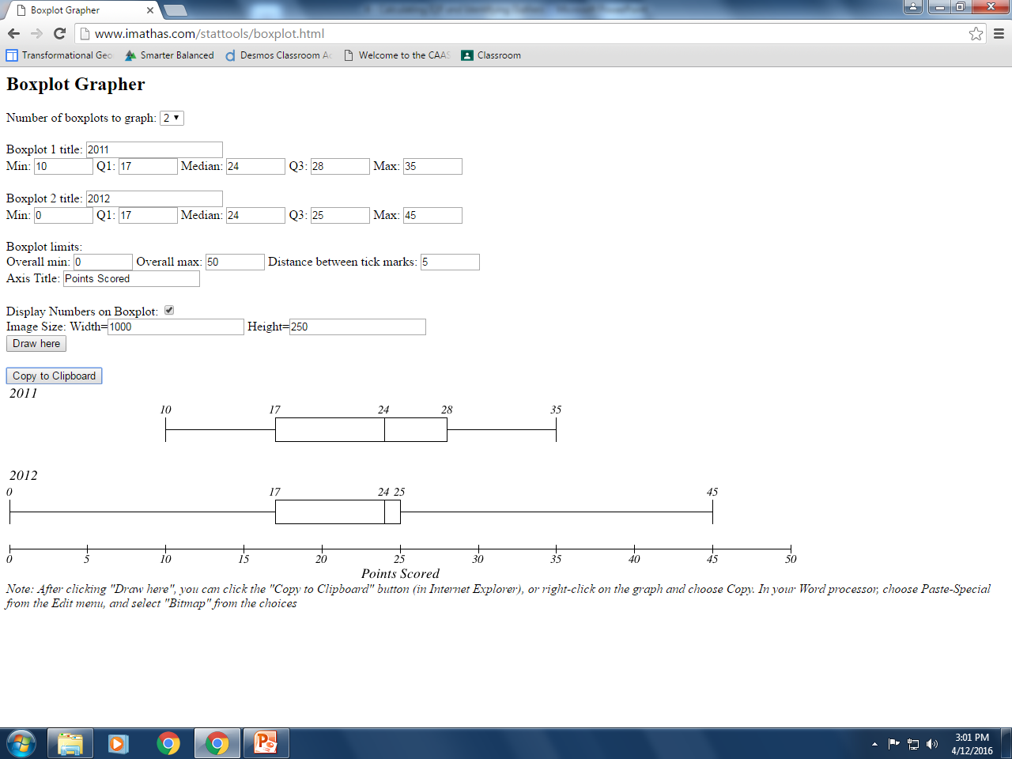
Warm-up:
Use
http://www.shodor.org/interactivate/activities/BoxPlot/
followed by
http://www.imathas.com/stattools/boxplot.html
to complete PROBLEM 1, Question 1 (parts a – e) on pages 480 – 481.

Slide 4
Another measure of data distribution that can be used to compare data is the interquartile range or IQR.
The INTERQUARTILE RANGE, IQR, measures how far the data is spread out from the median.
The IQR gives a realistic representation of the data without being affected by very high or very low data values. The IQR often helps show consistency within a data set.
The IQR is the range of the middle 50 percent of the data.
It is calculated by subtracting Q3 – Q1.
IQR = Q3 – Q1

Slide 5
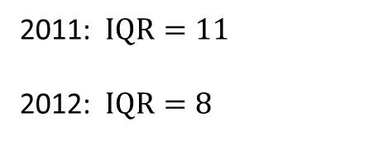
Complete Question 2 on Page 481:
Calculate the IQR for the points scored each year.
Then interpret the IQR for each year.
2011: $\text{IQR}=11$
2012: $\text{IQR}=8$

Slide 6
Another useful statistic when analyzing data is to determine if there are any outliers.
An OUTLIER is a data value that is significantly greater or lesser than other data values in a data set.
It is important to identify outliers because outliers can often affect the other statistics of the data set such as the mean.
An outlier is typically calculated by multiplying the IQR by 1.5 and then determining if any data values are greater or lesser than that calculated distance away from Q1 or Q3.
By calculating $Q1−(IQR∙1.5)$ and $Q3+(IQR∙1.5)$, you are determining a lower and upper limit for the data. Any value outside of these limits is an outlier.
The value of $Q1−(IQR∙1.5)$ is known as the LOWER FENCE
and
the value of $Q3+(IQR∙1.5)$ is known as the UPPER FENCE.

Slide 7
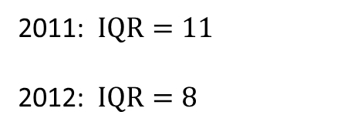
Use the information from Problem 1 to complete Questions 1 and 2 on Pages 483 and 484. [The information in the book is incorrect. Use your original data from Page 480.]
2011: $\text{IQR}=11$
2012: $\text{IQR}=8$

Slide 8
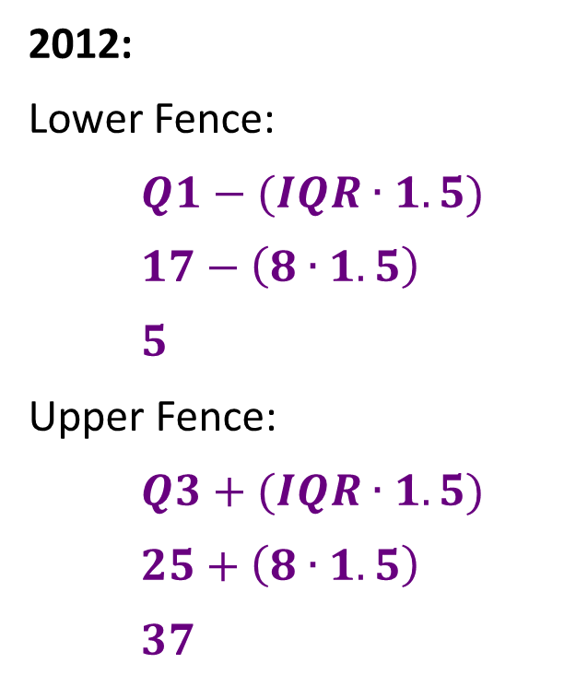
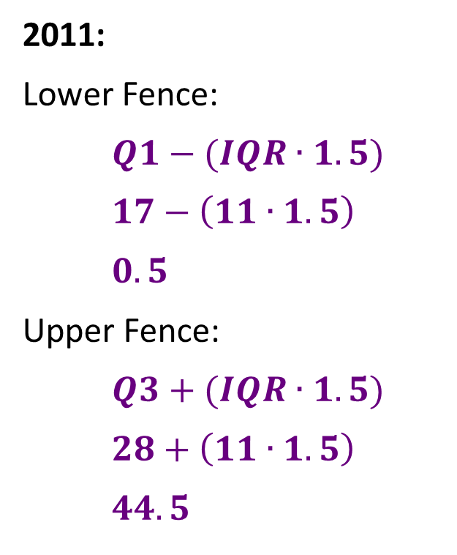
1. Use the formulas to determine if there are any outliers in either data set.
Determine the upper and lower fence for each year’s data set.
2011:
Lower Fence:
$$Q1−(IQR∙1.5)$$
$$17−\left(11∙1.5\right)$$
$$0.5$$
Upper Fence:
$$Q3+(IQR∙1.5)$$
$$28+\left(11∙1.5\right)$$
$$44.5$$
2012:
Lower Fence:
$$Q1−(IQR∙1.5)$$
$$17−\left(8∙1.5\right)$$
$$5$$
Upper Fence:
$$Q3+(IQR∙1.5)$$
$$25+\left(8∙1.5\right)$$
$$37$$
b. Identify any outliers in either set of data. Explain your reasoning.

Slide 9
2. Remove any outliers for the 2012 data set and, if necessary, reconstruct and label the box-and-whisker plot(s). Compare the IQR of the original data to your new calculations.
What do you notice?
Homework: PROBLEM 3, pages 484 – 486.

