Slide 1
Properties of Rotations
Essential Question?
How do you describe the properties of rotation and their effect on the congruence and orientation of figures?
8.G.1, 8.G.3

Slide 2
Common Core Standard:
8.G ─Understand congruence and similarity using physical models, transparencies, or geometry software.
1. Verify experimentally the properties of rotations, reflections, and translations:
a. Lines are taken to lines, and line segments to line segments of the same length.
b. Angles are taken to angles of the same measure.
c. Parallel lines are taken to parallel lines.
3. Describe the effect of dilations, translations, rotations, and reflections on two-dimensional figures using coordinates.

Slide 3
Objectives:
To describe the properties of rotation and their effect on the congruence and orientation of figures.

Slide 4
Properties of Rotations
A ROTATION is a TRANSFORMATION that turns a figure around a given point called the
CENTER OF ROTATION.
The image has the same size and shape as the preimage.
REMEMBER: When a point experiences a transformation, the resulting point is called PRIME. The symbol for prime is ´. i.e. point A becomes A´.

Slide 5
Properties of Rotations
A ROTATION can be:
CLOCKWISE
COUNTERCLOCKWISE
(if no specific direction is given, the rotation is counterclockwise)
This year you will only explore rotations that are multiples of 90⁰.
90⁰ 180⁰ 270⁰

Slide 6
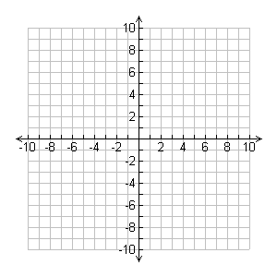
Triangle ABC (△ABC), shown on the coordinate plane, is the PREIMAGE (input).
We will explore rotation of the triangle 90⁰ counterclockwise around the origin.
C
△ABC (PREIMAGE)
B
A

Slide 7
Let’s see what a rotation looks like.
C
△ABC (PREIMAGE)
C ′
B ′
△A′B′C′ (IMAGE)
B
A′
A

Slide 8
Now let’s do the work:
First let us identify the CENTER OF ROTATION.
Think about what will happen to point A when you rotate the triangle.
Where will A´ appear?
C
△ABC (PREIMAGE)
B
A
A´
CENTER OF ROTATION

Slide 9
Now think about what will happen to $\overline{AB}$.
Where will $\overline{A´B´}$ appear?
Now think about what will happen to point C.
Where will C´ appear?
C
△ABC (PREIMAGE)
C´
B´
B
A
A´
CENTER OF ROTATION

Slide 10
ROTATIONS
What changed when we rotated △ABC?
The ORIENTATION of an image changes after a rotation.

Slide 11
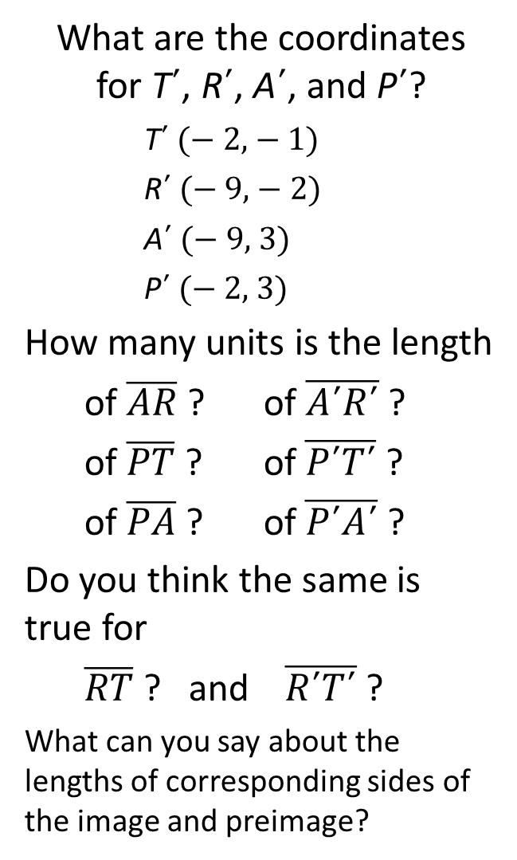
What are the coordinates for T´, R´, A´, and P´?
T´ (− 2, − 1)
R´ (− 9, − 2)
A´ (− 9, 3)
P´ (− 2, 3)
How many units is the length
$\text{of} \overline{AR}$ ? of $\overline{A´R´}$ ?
of $\overline{PT}$ ? of $\overline{P´T´}$ ?
of $\overline{PA}$ ? of $\overline{P´A´}$ ?
Do you think the same is true for
$\overline{RT}$ ? and $\overline{R´T´}$ ?
What can you say about the lengths of corresponding sides of the image and preimage?
Now let us examine trapezoid TRAP?
Rotate trapezoid TRAP 180⁰ around the origin .
Label the vertices of the image T´, R´, A´, and P´.
A´
P´
R
T
T´
R´
P
A

Slide 12
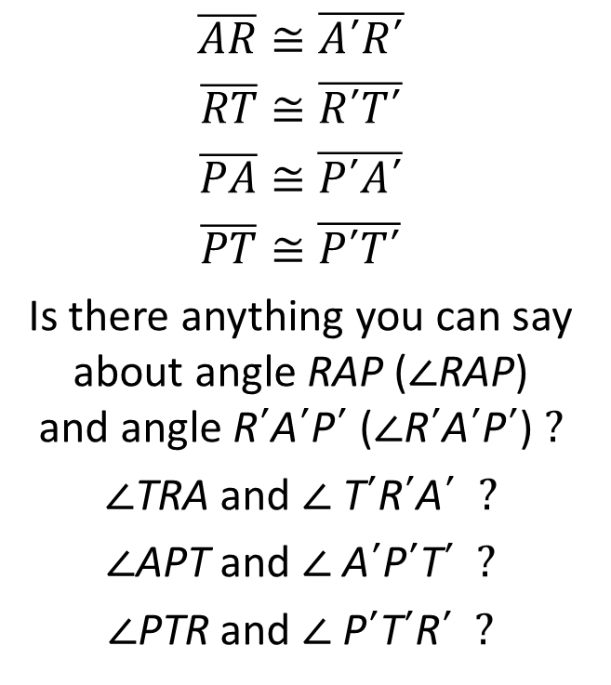
The measures of the corresponding sides of the image and preimage
are equal.
When measurements of line segments are equal, the word we use is
CONGRUENT
$$\overline{AR}≅\overline{A´R´}$$
$$\overline{RT}≅\overline{R´T´}$$
$$\overline{PA}≅\overline{P´A´}$$
$$\overline{PT}≅\overline{P´T´}$$
Is there anything you can say about angle RAP (∠RAP) and angle R´A´P´ (∠R´A´P´) ?
∠TRA and ∠ T´R´A´ ?
∠APT and ∠ A´P´T´ ?
∠PTR and ∠ P´T´R´ ?
A´
P´
R
T
T´
R´
P
A

Slide 13
The measures of the corresponding angles of the image and preimage
are equal.
When measurements of angles are equal, the word we use is
CONGRUENT
∠RAP ≅ ∠R´A´P´
∠TRA ≅ ∠ T´R´A´
∠APT ≅ ∠ A´P´T´
∠PTR ≅ ∠ P´T´R´
A´
P´
R
T
T´
R´
P
A

Slide 14
We now know that ALL corresponding sides of the image and preimage are CONGRUENT.
We also know that ALL corresponding angles of the image and preimage are CONGRUENT.
We can now say that trapezoid TRAP is CONGRUENT to trapezoid T´R´A´P´
TRAP ≅ T´R´A´P´
What do you think we can now say about the image and preimage after a rotations?
A´
P´
R
T
T´
R´
P
A

Slide 15
ROTATIONS
The IMAGE resulting from a ROTATION is THE EXACT SAME SHAPE & SIZE as the PREIMAGE!
The IMAGE resulting from a ROTATION is ALWAYS CONGRUENT to the PREIMAGE!
We now know that:
The image resulting from a TRANSLATION, REFLECTION, or ROTATION is CONGRUENT to its preimage!!!!
The only thing that changes with a rotation is the
ORIENTATION.

