Slide 1
Rational Exponents

Slide 2
Objective- To simplify expressions involving rational exponents

Slide 3
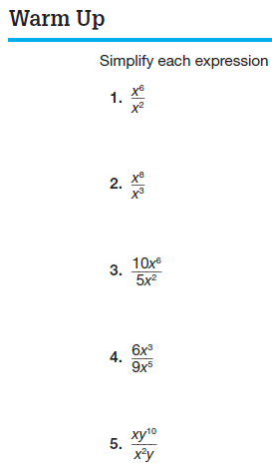

Slide 4
Bases and Exponents
exponent
x
3
x ∙ x ∙ x
=
base
The BASE tells us what is being multiplied.
The EXPONENT tells us how many times to multiply the base.

Slide 5
NOTE
a = a¹
You should always write the invisible 1 to help you with problems involving exponents.

Slide 6
Identifying the Base & Exponent
The base is 5. The exponent is 2.
The base is 5. The exponent is 2.
The base is - 5. The exponent is 2.
The base is (x+3). The exponent is 5.

Slide 7
Evaluating Exponents
The base is 5. The exponent is 2.
The base is - 5. The exponent is 2.

Slide 8
Exponent Vocabulary
When we raise something to the second power, we use the word
SQUARED
7²
Seven squared
When we raise something to the third power, we use the word
CUBED
5³
Five cubed

Slide 9
Simple Rule
If the base is negative:
  An even exponent means a positive answer
  An odd exponent means a negative answer
Example:

Slide 10
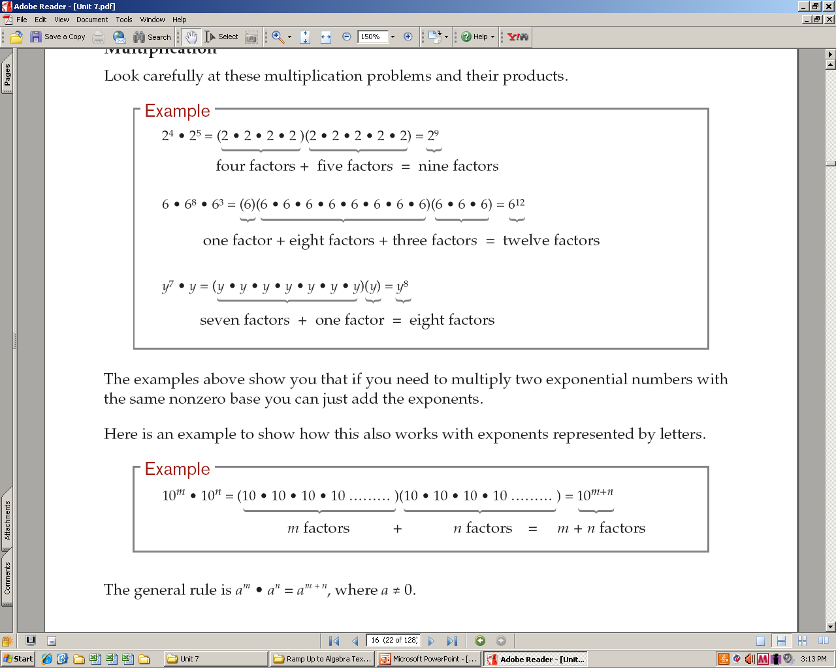
Multiplication Rules

Slide 11
Product of Powers Property
When you MULTIPLY quantities
with the same base
ADD the exponents.

Slide 12
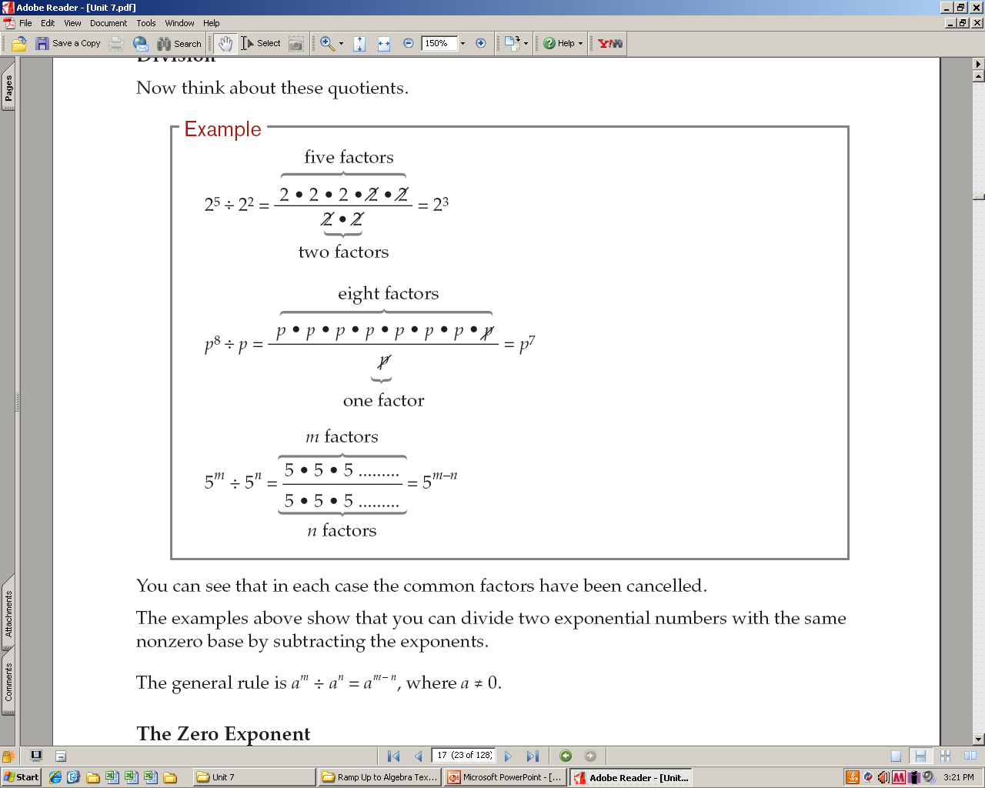
Division Rules

Slide 13
Quotient of Powers Property
When you DIVIDE quantities with the same base
SUBTRACT the exponents.
Always top exponent minus bottom exponent!

Slide 14
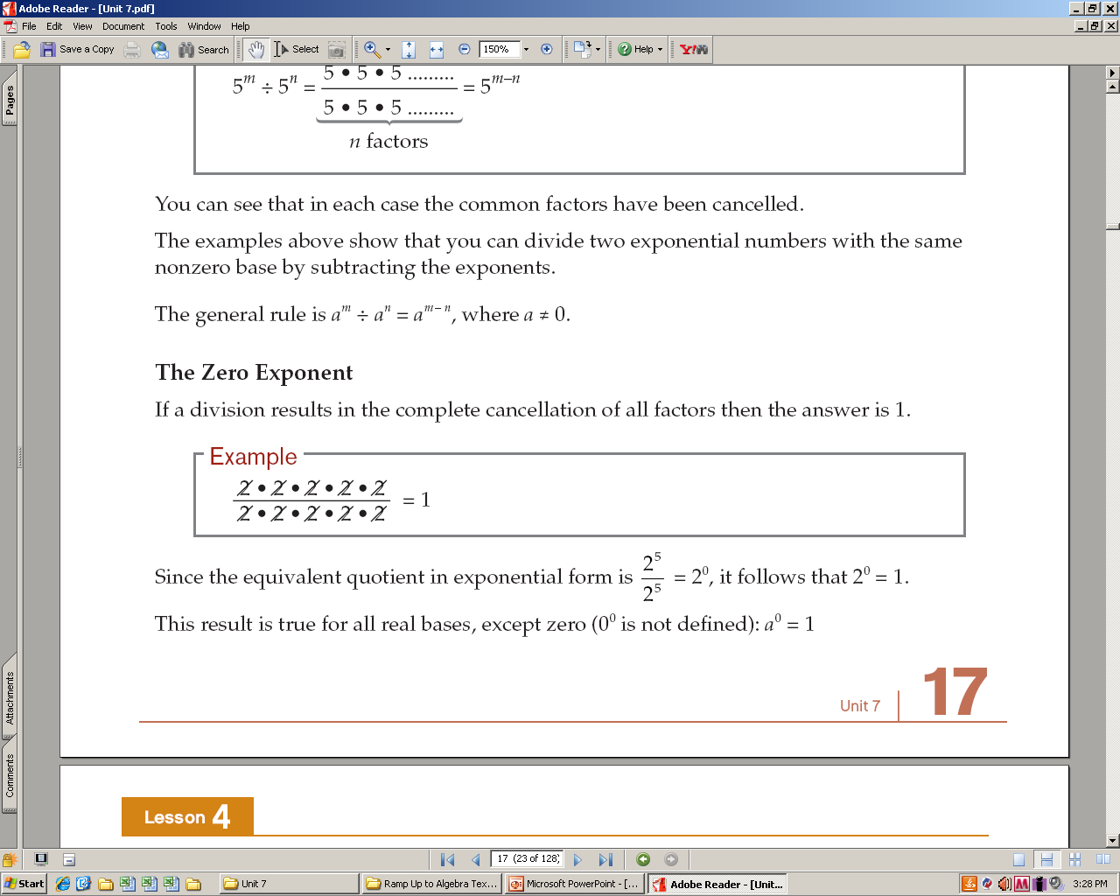
Zero Exponent Property
If a division results in the complete cancellation of all factors then the answer is 1.

Slide 15
TRY THESE
1
1
1
−1

Slide 16
Power of a Power Rule
Example:
Notes:
16

Slide 17
Power of a Product Rule
(Distributive Property of Exponents over Multiplication)
Example:
Notes:
17

Slide 18
Negative Exponent Property
For all real numbers a, a ≠ 0, and n is an integer:

Slide 19
Follow the Pattern!
=
3 3 3
=
3 3
=
3
=
1
=
=
=

Slide 20
Working with Negative Exponents
When you see a negative exponent,
think FRACTION!
If no fraction exists,
create a fraction,
by putting what you have over 1!
Examples:

Slide 21
Fractions As Bases
If you have a fraction as the base,
and there is a negative exponent:
FLIP THE FRACTION!
Example:

Slide 22
Simplify.
1)
3)
5)
2)
4)
6)

Slide 23



Simplify these:

Slide 24
A fractional exponent is a root of the base.
=
or
=
=

Slide 25
Simplify.
1)
=
=
4)
=
=
2)
=
=
5)
=
=
3)
=
=
6)
=
=

Slide 26
Roots of Negative Numbers
1)
=
=
No Real Root
–4 ● – 4 ≠ – 16
2)
=
=
3)
=
=
4)
=
=
No Real Root

Slide 27
Write using a root. Simplify.
1)
=
=
No Real Root
2)
=
=
3)
=
=
No Real Root
4)
=
=

Slide 28
Write using a root. Simplify.
5)
=
=
6)
=
=
No Real Root
7)
=
=
8)
=
=

Slide 29
Rule of Rational Exponents
=
or
=
=
power (exponent)
Root or power first?
root
Doesn’t matter!
=
=
=
=
=
=
=
=

Slide 30

power (exponent)
root

Slide 31
Simplify.
1)
=
=
=
2)
=
=
=
3)
=
=
=
4)
=
=
=

Slide 33
Simplify.
5)
=
=
=
6)
=
=
=
7)
=
=
=
8)
=
=
=

Slide 34
Simplify the root first.
Simplify the power first.
1)
a)
=
=
=
b)
=
=
=
2)
a)
=
=
=
b)
=
=
=

