Slide 1
Calculating and
Interpreting Standard Deviation

Slide 2
Objectives:
  To calculate and interpret the standard deviation of a data set
  To compare the standard deviation of data sets

Slide 3
Warm-up: Complete Problem 1, Questions 1 – 5, on pages 490 – 491.
Use
http://www.shodor.org/interactivate/activities/BoxPlot/
followed by
http://www.imathas.com/stattools/boxplot.html
to construct the box-and-whisker plots.
1. Determine the mean and median for each student’s spelling bee scores.
        Jack: Mean = 50 Median = 49.5
        Aleah: Mean = 50 Median = 50
        Tymar: Mean = 50 Median = 50
2. What conclusions can you draw about the data from the mean and median scores?

Slide 4
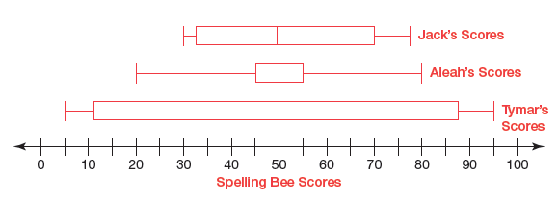
3. Construct box-and-whisker plots of each student’s spelling bee scores using the same number line.
4. Interpret the test scores of each student.
5. Do you think these three students performed about the same on all the tests? Why or why not?

Slide 5
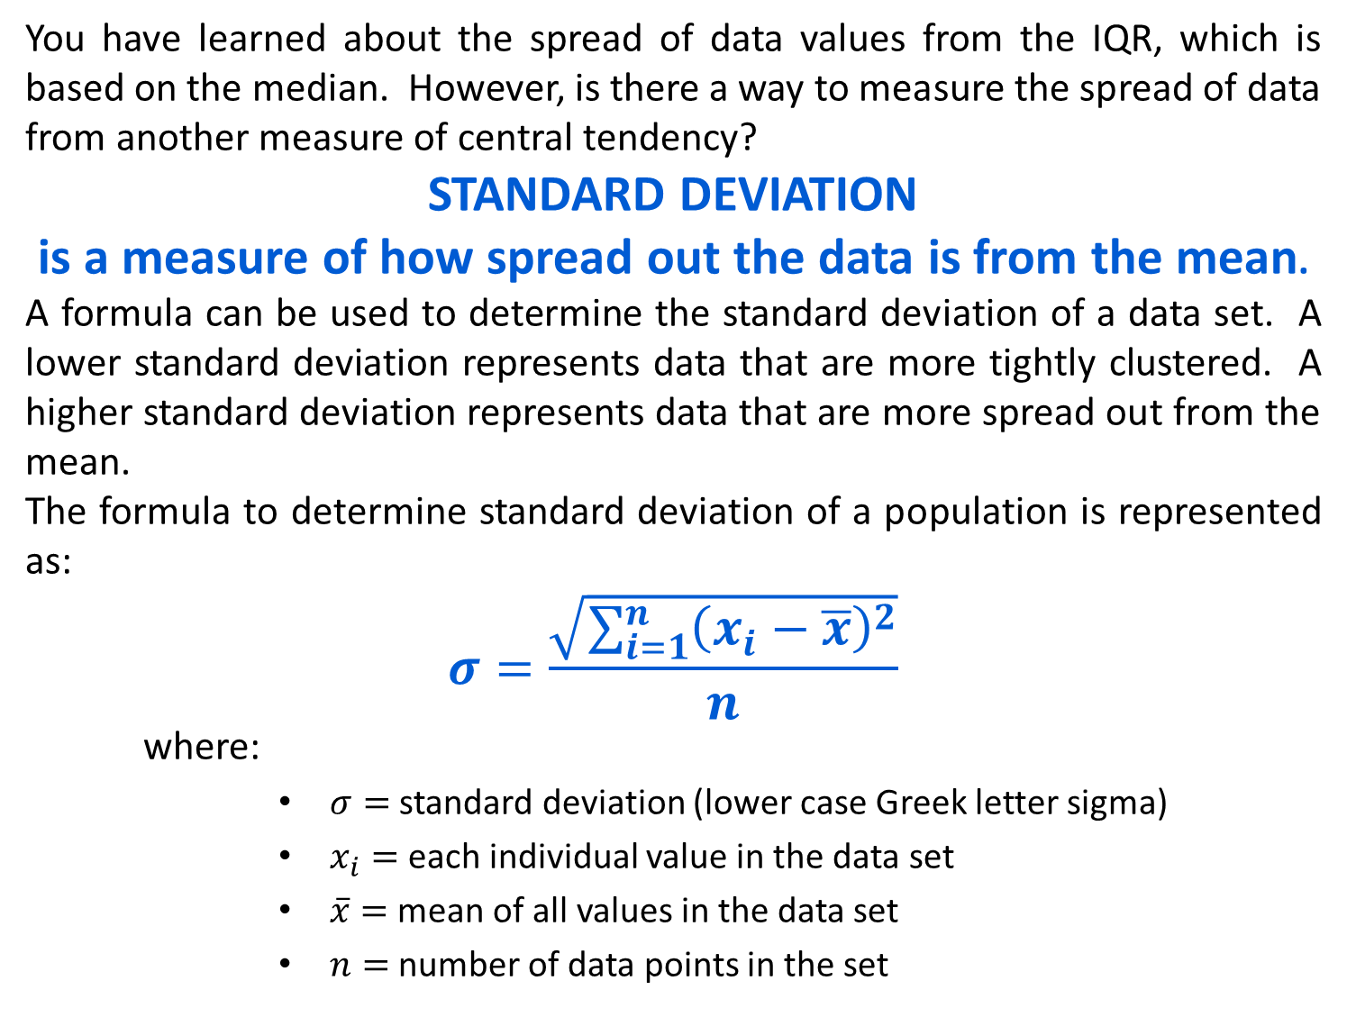
You have learned about the spread of data values from the IQR, which is based on the median. However, is there a way to measure the spread of data from another measure of central tendency?
STANDARD DEVIATION
is a measure of how spread out the data is from the mean.
A formula can be used to determine the standard deviation of a data set. A lower standard deviation represents data that are more tightly clustered. A higher standard deviation represents data that are more spread out from the mean.
The formula to determine standard deviation of a population is represented as:
$$σ=\frac{\sqrt{\sum_{i=1}^{n}{{\left(x_{i}−\overline{x}\right)}^{2}}}}{n}$$
    where:
        $σ=$ standard deviation (lower case Greek letter sigma)
        $x_{i}=$ each individual value in the data set
        $\overline{x}=$ mean of all values in the data set
        $n=$ number of data points in the set

Slide 6
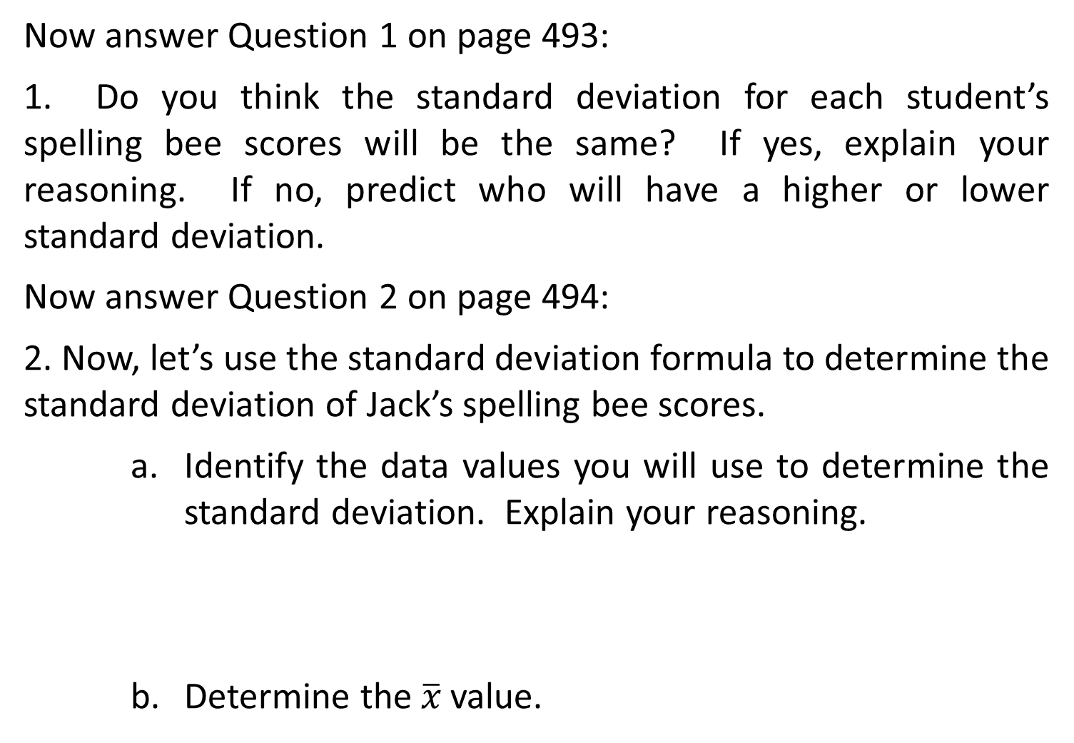
Now answer Question 1 on page 493:
1. Do you think the standard deviation for each student’s spelling bee scores will be the same? If yes, explain your reasoning. If no, predict who will have a higher or lower standard deviation.
Now answer Question 2 on page 494:
2. Now, let’s use the standard deviation formula to determine the standard deviation of Jack’s spelling bee scores.
    Identify the data values you will use to determine the standard deviation. Explain your reasoning.
    Determine the $\overline{x}$ value.

Slide 7
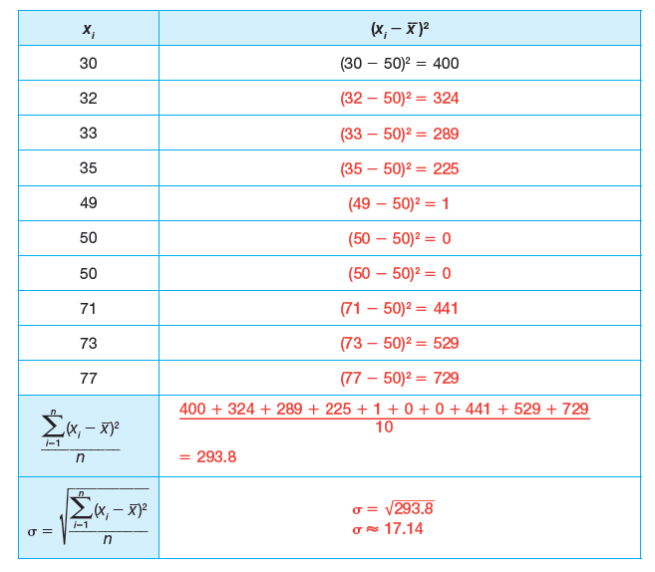
c. Complete the table to represent each part of the formula. The data values have been put in ascending order.

Slide 8
3. Determine the standard deviation for Jack’s spelling bee scores and interpret the meaning.

Slide 9
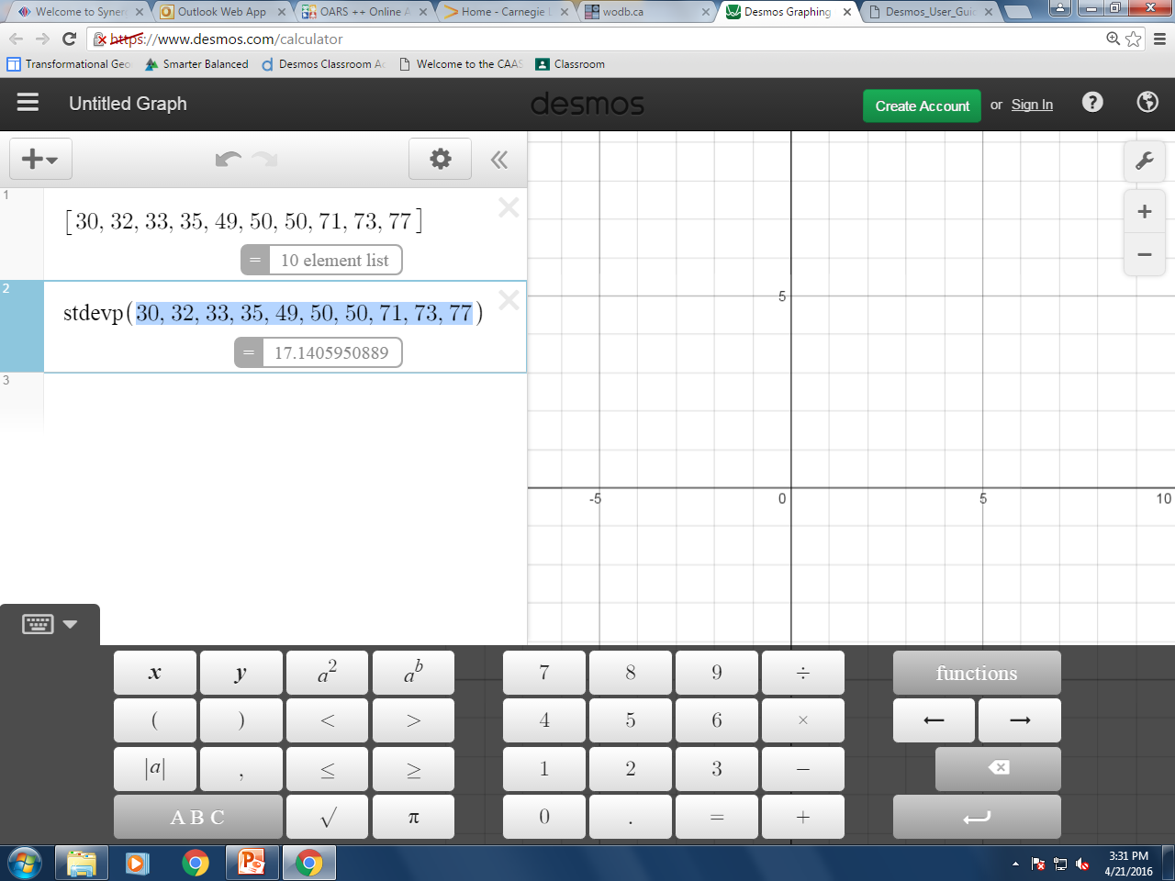
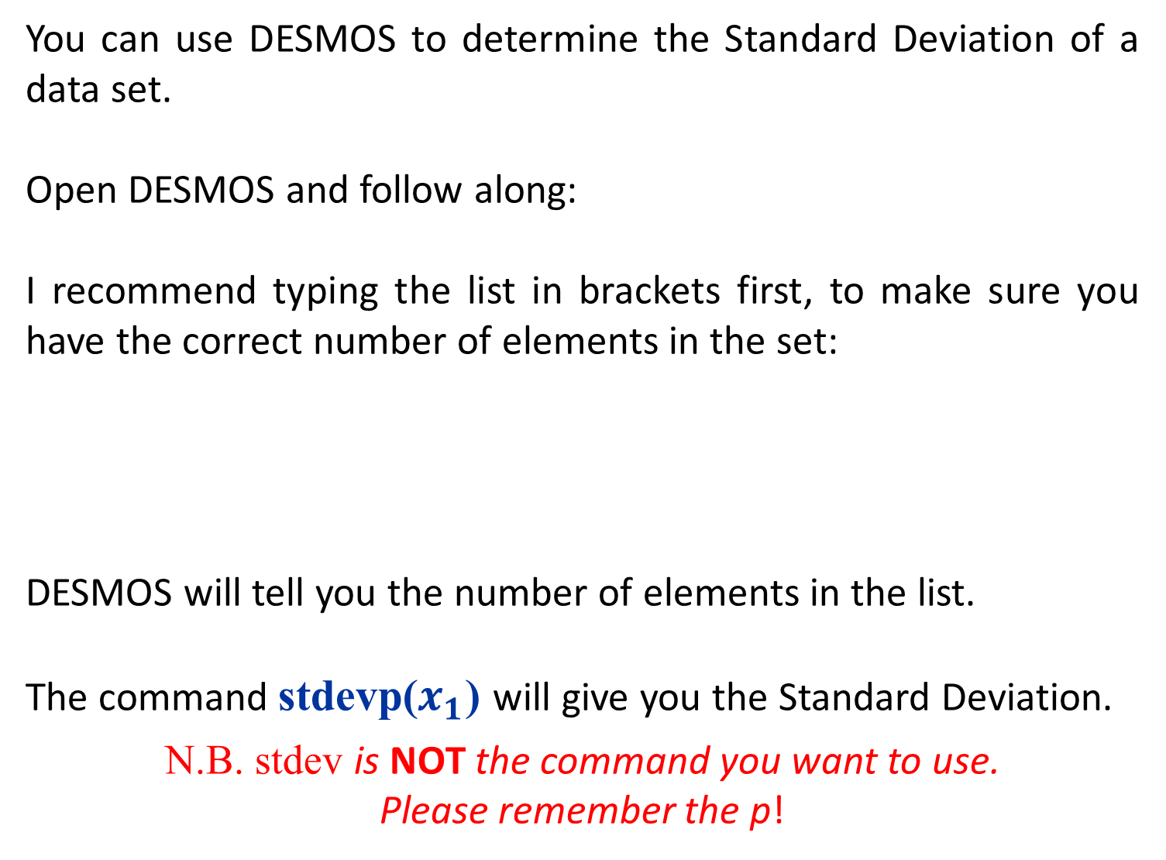
You can use DESMOS to determine the Standard Deviation of a data set.
Open DESMOS and follow along:
I recommend typing the list in brackets first, to make sure you have the correct number of elements in the set:
DESMOS will tell you the number of elements in the list.
The command stdevp($x_{1}$) will give you the Standard Deviation.
N.B. stdev is NOT the command you want to use.
Please remember the p!

Slide 10
Highlight and copy (CTRL C) the list of elements to paste (CTRL V) them into the next line of DESMOS:

Slide 11
Now use DESMOS to complete Questions 4 – 6 on Page 495:
4. Use DESMOS to determine the standard deviation of Aleah’s and Tymar’s spelling bee scores.
        Aleah: Standard Deviation ≈ 14.14 points
        Tymar: Standard Deviation ≈ 32.23 points
5. Was the prediction you made in Question 1 correct? What do the standard deviations tell you about each student’s spelling bee scores?
6. Which student do you think Ms. Webb should add to the spelling bee roster? Use the standard deviation for the student you recommend to add to the roster to justify your answer.

Slide 12
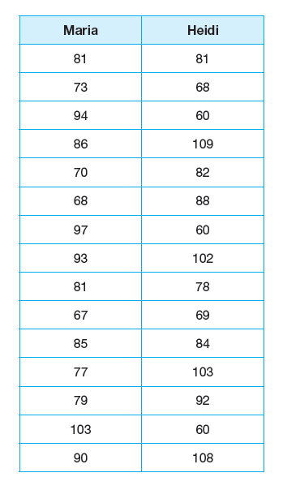
Now use DESMOS to complete Problem 1, Question 4 on pages 497 – 498:
1. Analyze each student’s spelling bee scores.
  Determine the mean spelling bee score for each student.
Recall that Ms. Webb is the spelling bee coach in Problem 1, Spelling SUCCESS. Her class is preparing for their first spelling bee scrimmage. Ms. Webb needs to determine which student should be the spelling bee captain. Ms. Webb believes the captain should have the greatest mean score of the team. The two top spelling bee students’ scores are shown.

Slide 13
Ms. Webb wants to also use the standard deviation to help her determine which student is a more consistent speller.
  Determine the standard deviation of Maria’s scores. Then determine the value of the spelling bee scores that are 1 standard deviation from the mean. Explain how you determined her spelling bee point values.
  Determine the standard deviation of Heidi’s scores. Then determine the value of the spelling bee scores that are 1 standard deviation from the mean. Explain how you determine her spelling bee point values.

Slide 14
Once you have found 1 standard deviation, it is easy to determine different numbers of standard deviations:
2 standard deviations = 2∙(1 standard deviation)
3 standard deviations = 3∙(1 standard deviation)
When you determine the standard deviation of a data set, you can represent it graphically. You can also determine the general percent of data values that are within 1 standard deviation, and the percent of data values that lie within 2 standard deviations in normal distributions.
A NORMAL DISTRIBUTION is a collection of many data points that form a bell-shaped curve.

Slide 15
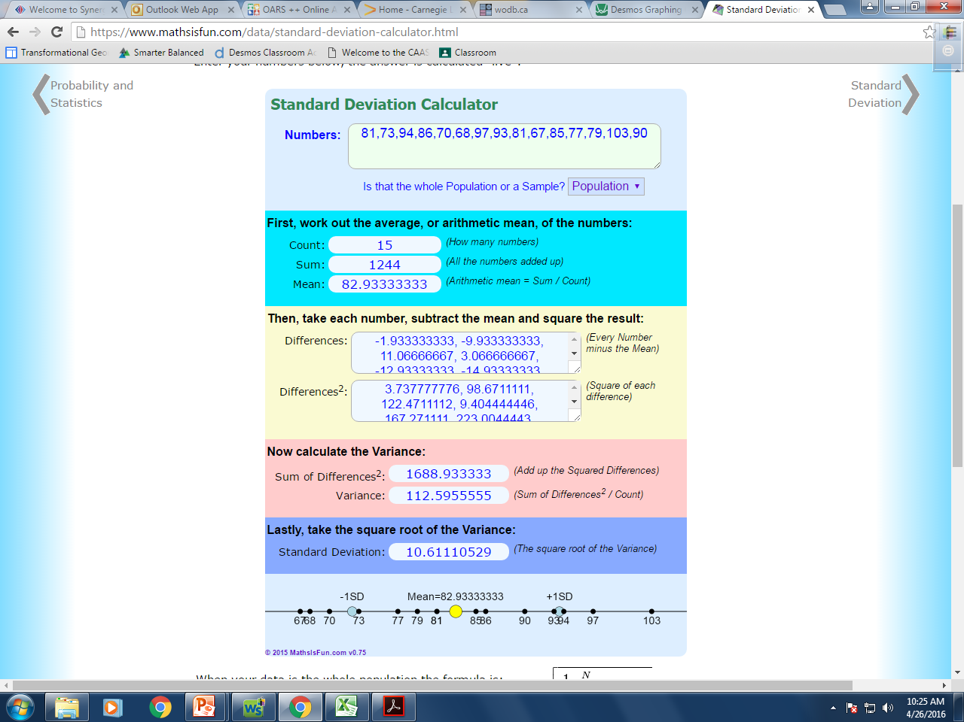
Let’s follow along on pages 499 – 500 and utilize some technology to help:
Visit:
https://www
mathsisfun.com/
data/standard-deviation-calculator.html
and type in the information for Maria’s spelling bee scores, found on page 497.

Slide 16
You will notice the added feature a the bottom of the page, that DESMOS does not provide:
A number line with the mean and 1 standard deviation already plotted for you.
You can use this information to help you to create your graph by marking the dotted lines needed for the first standard deviation.

Slide 17
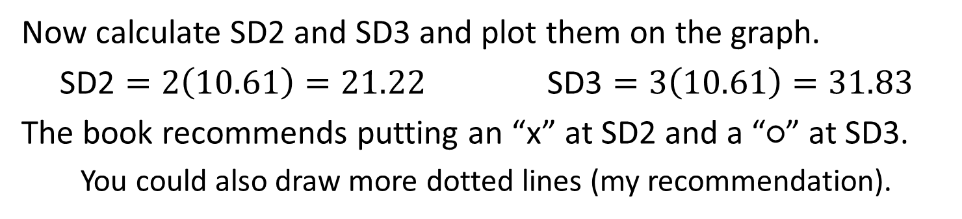
Now calculate SD2 and SD3 and plot them on the graph.
$\text{SD}\text{2}=2\left(10.61\right)=21.22$ $\text{SD}\text{3}=3\left(10.61\right)=31.83$
The book recommends putting an “x” at SD2 and a “○” at SD3.
You could also draw more dotted lines (my recommendation).
51.10
61.71
104.15
114.76

Slide 18
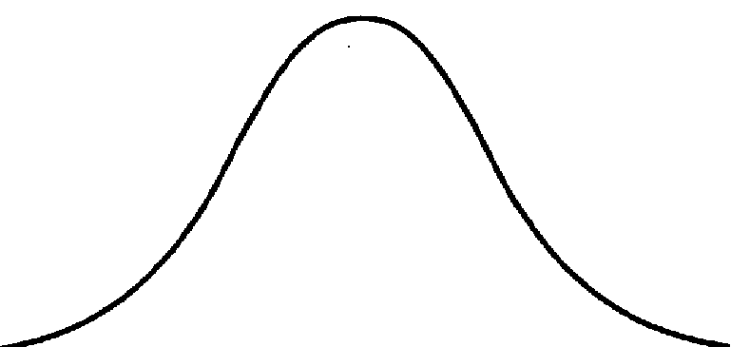
Finally, draw a smooth bell-shaped curve starting from the far left minimum value to the far left maximum value.
51.10
61.71
104.15
114.76

Slide 19
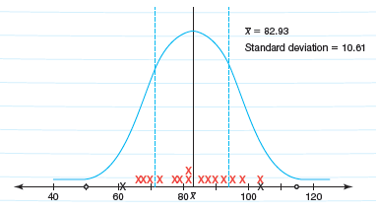
Now complete questions 2 – 3 on pages 500 – 501:
2. Describe some observations you can make about the graph of Maria’s spelling bee scores.
3. Plot each of Maria’s scores on the graph of the worked example. Mark an “x” for the approximate location on the number line for each score.
a. Determine how many spelling bee scores are within 1 standard deviation of the mean for Maria’s spelling bee scores.
9 scores are within one standard deviation

Slide 20
b. Determine how many spelling bee scores are within 2 standard deviations of the mean for Maria’s spelling bee scores.
15 scores are within two standard deviations.
The entire data set falls within two standard deviations of the mean.
c. Determine how many spelling bee scores are within 3 standard deviations of the mean for Maria’s spelling bee scores.
Since the entire data set falls within two standard deviations,
it also falls within three standard deviations.

Slide 21
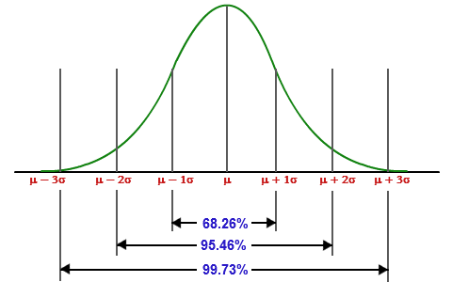
Within the graph of a normal distribution, you can predict the percent of data points that are within one, two, or three standard deviations from the mean.
Generally:
    68% of the data points of a data set will fall within one standard deviation of the mean
    95% of the data points of a data set will fall within two standard deviations of the mean
    99% of the data points of a data set will fall within three standard deviations of the mean

Slide 22
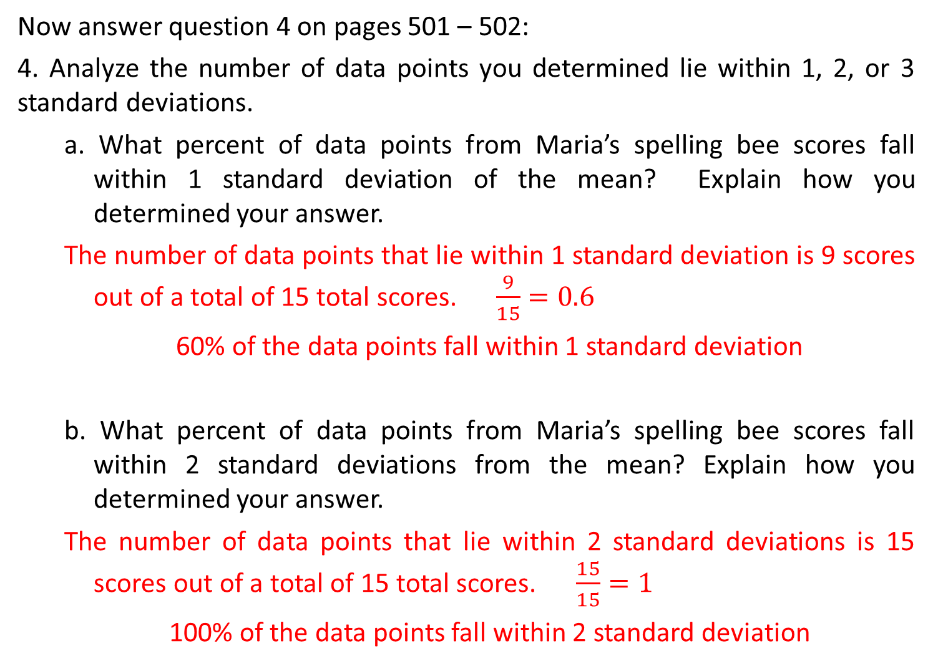
Now answer question 4 on pages 501 – 502:
4. Analyze the number of data points you determined lie within 1, 2, or 3 standard deviations.
  a. What percent of data points from Maria’s spelling bee scores fall within 1 standard deviation of the mean? Explain how you determined your answer.
  The number of data points that lie within 1 standard deviation is 9 scores out of a total of 15 total scores. $\frac{9}{15}=0.6$
  60% of the data points fall within 1 standard deviation
  b. What percent of data points from Maria’s spelling bee scores fall within 2 standard deviations from the mean? Explain how you determined your answer.
  The number of data points that lie within 2 standard deviations is 15 scores out of a total of 15 total scores. $\frac{15}{15}=1$
  100% of the data points fall within 2 standard deviation

Slide 23
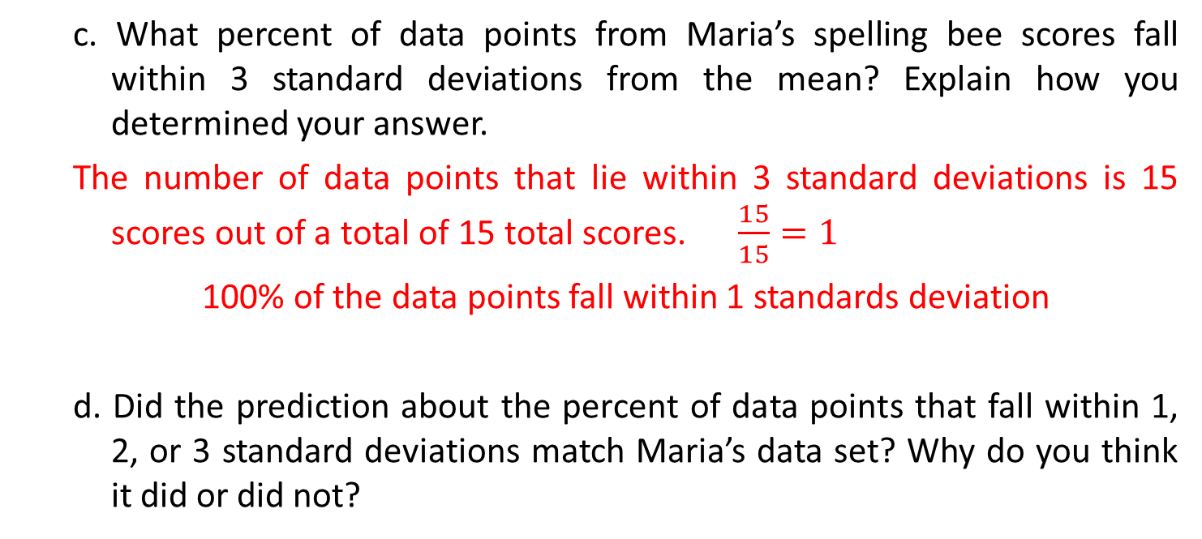
  c. What percent of data points from Maria’s spelling bee scores fall within 3 standard deviations from the mean? Explain how you determined your answer.
  The number of data points that lie within 3 standard deviations is 15 scores out of a total of 15 total scores. $\frac{15}{15}=1$
  100% of the data points fall within 1 standards deviation
  d. Did the prediction about the percent of data points that fall within 1, 2, or 3 standard deviations match Maria’s data set? Why do you think it did or did not?

Slide 24
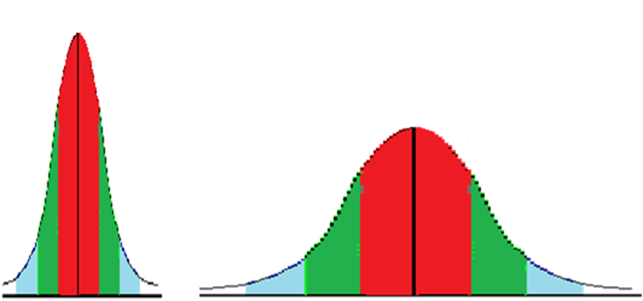
It is important to note that the guideline regarding
68%, 95% and 99% is a guideline.
There are some data sets in which all of the data points lie within two standard deviations of the mean while other data sets may actually need four or greater standard deviations to encapsulate the entire data set.
It is important to know that because standard deviation is based on the mean of a data set, outliers may affect the standard deviation of the data set.
Compare these two data sets and see if you can come to any conclusions:

Slide 25
HOMEWORK:
    Talk the Talk page 503
    Chapter 8.5 (pages 505 – 511)

