Slide 1
Solving Exponential Functions

Slide 2
Objective- To solve exponential functions

Slide 3
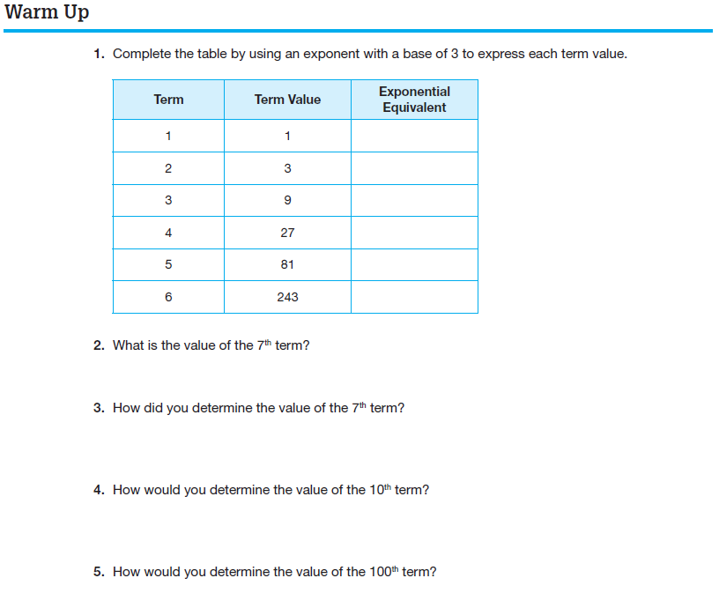

Slide 4
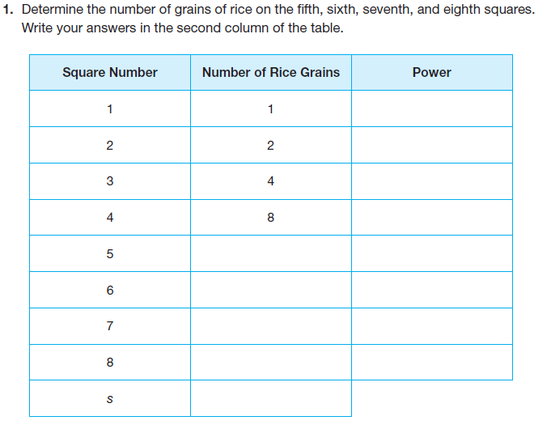
Let’s read together PROBLEM 1 on Page 348:
Complete the second column of the table in Question 1:

Slide 5
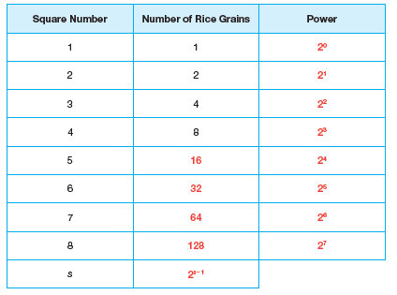
What pattern do you notice in the table?
A chessboard has 64 squares. Predict how many grains of rice must be on the 64th square if the pattern continues.
Do you think the emperor made a good deal for himself?

Slide 6
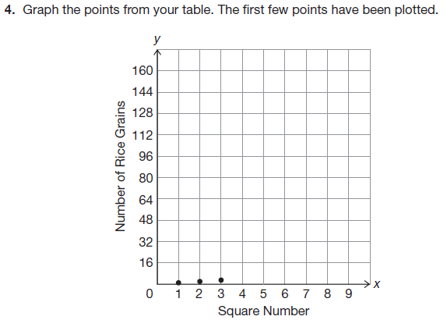
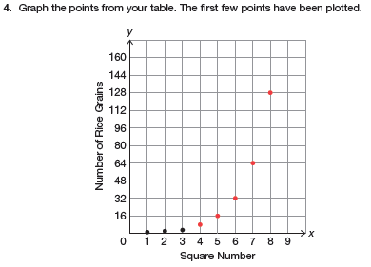
Complete Question 4 on Page 349:

Slide 7
Does it make sense to connect the points on this graph?
Now complete the third column of the table in Question 1, Page 348:

Slide 8
Analyze the third column in the table and write an algebraic expression in the last row to determine the number of grains of rice for any square number.
Write an equation in function notation to represent the number of rice grains as a function of the square number, s.
Complete 7b on Page 349. Be ready to share your answer.

Slide 9
Now use properties of exponents to verify that
$2^{s−1}$ and $\frac{1}{2}{(2)}^{s}$ are equivalent.

Slide 10
Use properties of exponents to verify:
If $f(x)=5^{x}$ and $g(x)=5^{x+2}$
show $g(x)=25∙f(x)$

Slide 11
Use properties of exponents to verify:
If $r(x)=3^{−x+1}$ and $p(x)=3^{−x}$
show $p(x)=\left(\frac{1}{3}\right)∙r(x)$

Slide 12
Now use DESMOS to answer questions 9 – 10 on pages 350 – 351.

Slide 13
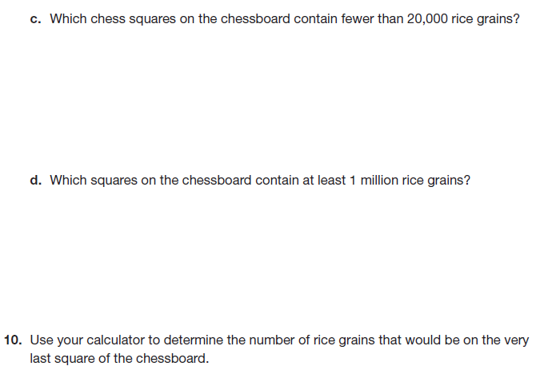
DESMOS

Slide 14
Solving Exponential Functions
REMEMBER:
An exponential function is a function written in the form
$$f(x)=a∙b^{x}$$
To solve an exponential function, you can use the properties you know about exponents and common bases.
Example:
Solve $\frac{1}{32}=2^{x−1}$
Ask yourself, 2 to what power equals 32?
$$2^{5}=32$$

Slide 15
Solve $\frac{1}{32}=2^{x−1}$
Since $2^{5}=32$
$\frac{1}{32}=2^{x−1}$ can be rewritten as $\frac{1}{2^{5}}=2^{x−1}$
Now work with properties of exponents:
$$\frac{1}{2^{5}}=2^{x−1}$$
$$2^{−5}=2^{x−1}$$
Since the bases are equivalent, the exponents must be equivalent !!!
$$−5=x−1$$
$$x=−4$$

Slide 16
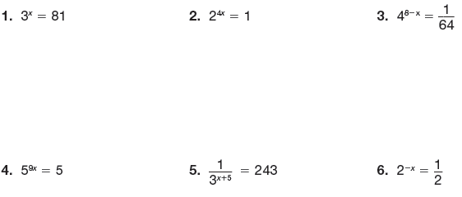
Solve questions 1 – 6 on page 352:

Slide 17
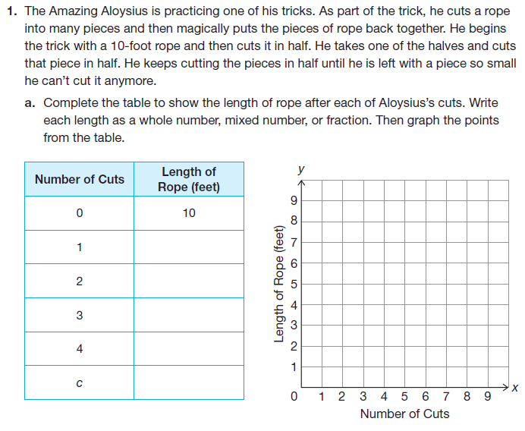
Let’s now work together on PROBLEM 3, pages 353 – 354:

Slide 18
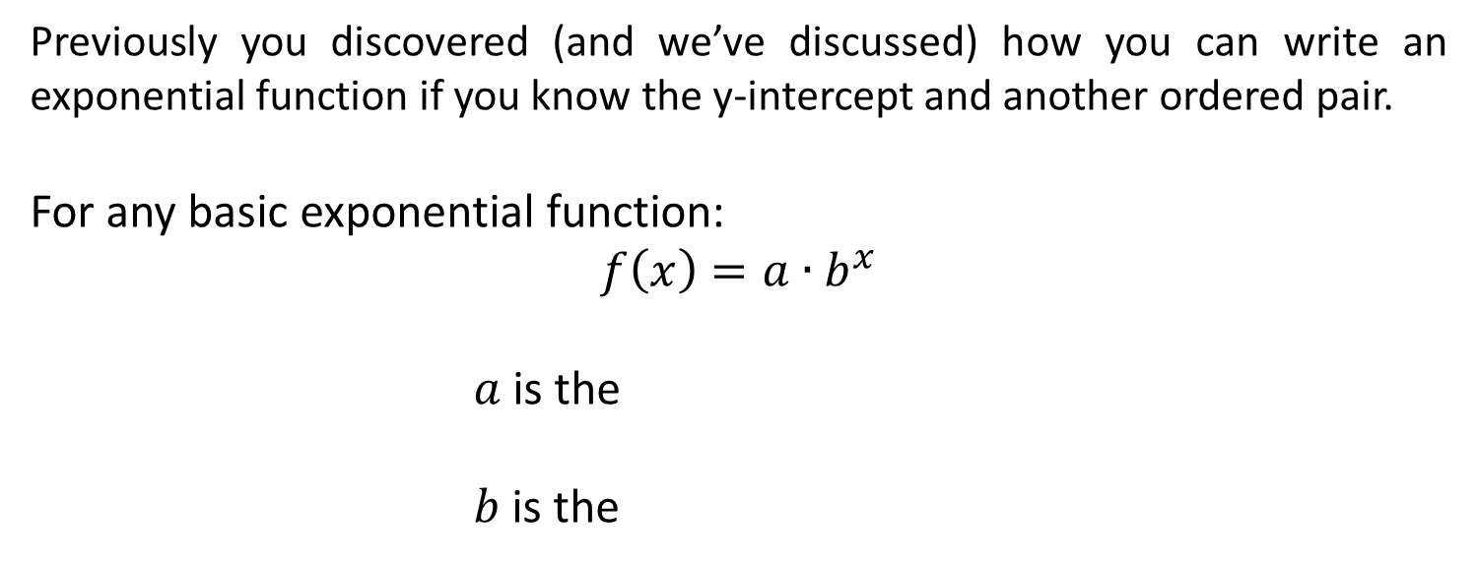
Previously you discovered (and we’ve discussed) how you can write an exponential function if you know the y-intercept and another ordered pair.
For any basic exponential function:
$$f\left(x\right)=a∙b^{x}$$
$a$ is the
$b$ is the
y-intercept $(0,a)$
common ratio (between any two points)

