Slide 1
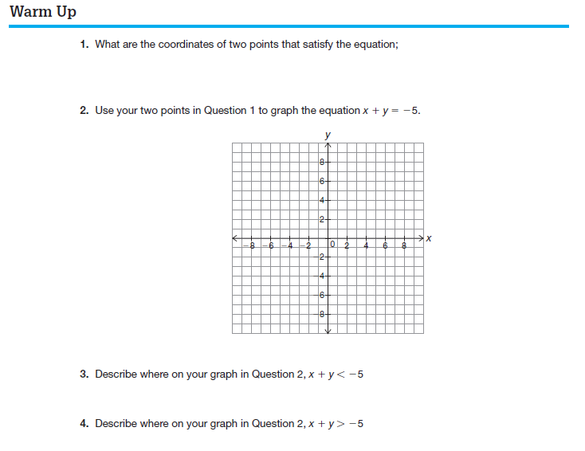
$$x+y=−5$$

Slide 2
Linear Inequalities
CA 6.0

Slide 3
Objective - To graph inequalities on the coordinate plane.

Slide 4
Recall…
Graph n < 3 on a number line.
-3 -2 -1 0 1 2 3 4

Slide 5
Graphing Inequalities
The following table will help you in graphing inequalities.
 | Shade Up | Shade Down
Solid Line | ≥ | ≤
Dashed Line | > | <

Slide 6
Graphing Inequalities
Step 1: Put the inequality in “Slope-Intercept Form.”
Step 2: Graph the boundary line.
Step 3: Shade the region. Use the y-intercept to determine up or down
The graph of a linear inequality is a
HALF-PLANE
(or half of a coordinate plane)

Slide 7
Graph y -3x + 2 on the coordinate plane.
$$≥$$
y
Boundary Line
y = -3x + 2
m = -3
b = 2
x
 | Shade Up | Shade Down
Solid Line | ≥ | ≤
Dashed Line | > | <

Slide 8
Determining a Solution
y
Solutions to a linear inequality are all the points that lie in the shaded region.
x

Slide 9
Graph x -2 on the coordinate plane.
$$≤$$
y
x

Slide 10
Graph y > 3 on the coordinate plane.
y
x

Slide 11
Graph on the coordinate plane.
3x - 4y > 12
-3x -3x
y
-4y > -3x + 12
-4 -4
$$\frac{3}{4}$$
y < x - 3
x
Boundary Line
m =
$$\frac{3}{4}$$
b = -3

Slide 12
Problem
If you have less than $5.00 in nickels and dimes,
find an inequality and sketch a graph to describe
how many of each coin you have.
Let n = # of nickels
Let d = # of dimes
0.05 n + 0.10 d < 5.00
or
5 n + 10 d < 500

Slide 13
5n + 10d < 500
n
d
d
0
50
60
50
40
30
20
10
0
100
0
n
0 10 20 30 40 50 60 70 80 90 100

