Slide 1
Congruent Figures
Essential Question?
How can transformations be used to verify that two figures have the same shape and size?
8.G.2

Slide 2
Common Core Standard:
8.G ─ Understand congruence and similarity using physical models, transparencies, or geometry software.
2. Understand that a two-dimensional figure is congruent to another if the second can be obtained from the first by a sequence of rotations, reflections, and translations; given two congruent figures, describe a sequence that exhibits the congruence between them.

Slide 3
Objectives:
To describe the effect of a translation, rotation, or reflections in relationship to the congruence of an image and its preimage.

Slide 4
Transformations
The transformations we have studied so far do not change the size or shape of the original figure.
Since the lengths of corresponding sides are equal and the measures of corresponding angles are equal, we can say that the image and preimage are
CONGRUENT
Two figures are CONGRUENT if there is a sequence of isometries of the plane onto itself that map one figure onto the other.

Slide 5
Transformations
An ISOMETRY is a RIGID MOTION. Distances and angle measures are preserved.
The ISOMETRIC transformations (preserve congruence) are:
TRANSLATIONS
REFLECTIONS
ROTATIONS
The ONLY thing that could change when a figure undergoes a series (composition) of isometric transformations is the figure’s
ORIENTATION

Slide 6
ORIENTATION
The isometric transformations that preserve ORIENTATION are:
TRANSLATIONS
The isometric transformations that change ORIENTATION are:
REFLECTIONS
ROTATIONS

Slide 7
Properties of ISOMETRIES
DISTANCE
Distance is preserved
Lines are taken to lines, line segments are taken to line segments of the same length
PARALLELISM
Parallelism is preserved
Parallel lines are taken to parallel lines
ANGLE MEASURE
Angle measure is preserved
Angles are taken to angles of the same measure

Slide 8
Properties of ISOMETRIES
CO-LINEARITY
Co-linearity is preserved
If three points lie on the same line, then their images lie on the same line
BETWEENNESS
Betweenness is preserved
If B is between A and C on a line, then B´ is between A´ and C´ on the images
A´
B´
C´
A
B
C

Slide 9
Transformations
When you are told that two figures are congruent, there MUST be a sequence of translations, reflections, and/or rotations that transforms one into the other.

Slide 10
FOLDABLE
ISOMETRIC TRANSFORMATIONS
(RIGID MOTION - Preserve congruence)
TRANSLATIONS
REFLECTIONS
ROTATIONS

Slide 11
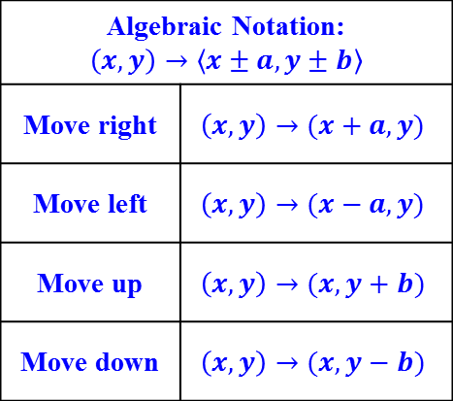
TRANSLATIONS
(orientation preserved)
REFLECTIONS
(orientation NOT preserved)
ROTATIONS
(orientation NOT preserved)
A transformation of a figure that moves (slides) a figure along a vector.
A transformation of a figure that flips the figure across a line called the line of reflection.
A transformation in which a figure is turned around a point called the center of rotation.
Algebraic Notation: $$\left(x,y\right)→\left\langle x±a, y±b\right\rangle$$
Move right | $$\left(x,y\right)→(x+a, y)$$
Move left | $$\left(x,y\right)→(x−a, y)$$
Move up | $$\left(x,y\right)→(x, y+b)$$
Move down | $$\left(x,y\right)→(x, y−b)$$
Algebraic Notation:
Across the x-axis | $$\left(x,y\right)→(x,−y)$$
Across any horizontal line 𝑦=𝑏 | $$(x,y)→(x, −y+2b)$$
Across the y-axis | $$\left(x,y\right)→(−x, y)$$
Across any vertical line 𝑥=𝑎 | $$(x,y)→(−x+2a, y)$$
Across $y=x$ | $$(x,y)→(y,x)$$
Across $y=−x$ | $$(x,y)→(−y,−x)$$
Algebraic Notation: only if the center of rotation is the origin
90° clockwise | $$\left(x,y\right)→(y, −x)$$
90° counter- clockwise | $$\left(x,y\right)→(−y,x)$$
180° | $$\left(x,y\right)→(−x,−y)$$
No direction means counterclockwise
ORIENTATION: The relative physical DIRECTION of a figure.
CONGRUENT: Having the same size and shape. The symbol for congruent is ≅.
The image resulting from an ISOMETRY (TRANSLATION, REFLECTION, or ROTATION) is CONGRUENT to its pre-image!!!!

