Slide 1
Constant Functions & Linear Non-Functions

Slide 2
Objective - To identify constant functions and linear non-functions

Slide 3
Constant Functions and Linear Non-Functions
Recall that there are four kinds of slope:
Positive Slope
Line is ascending
Negative Slope
Line is descending
Zero Slope
Line is Horizontal
Undefined Slope
Line is Vertical

Slide 4
Linear Functions
Equations of lines that are FUNCTIONS can be written in:
FUNCTION FORM
(Slope-Intercept Form)
$$y=mx+b$$

Slide 5

Constant Functions and Linear Non-Functions
Which kinds of slope give us functions?
Positive Slope
Line passes the vertical line test $$y=+mx+b$$
Negative Slope
Line passes the vertical line test $$y=−mx+b$$
Zero Slope
Line passes the vertical line test $$y=0x+b$$
$$\underset{→}{} y=b$$

Slide 6
Constant Functions
We have just seen that a HORIZONTAL LINE takes the special form:
$y=b$ (where b is a constant)
What would the following lines look like on a graph?
$$y=4$$

Slide 7
$$y=−3$$

Slide 8
$$y=2.5$$

Slide 9
$$y=0$$
The equation $y=0$ is the equation for the
$$x−axis$$

Slide 10
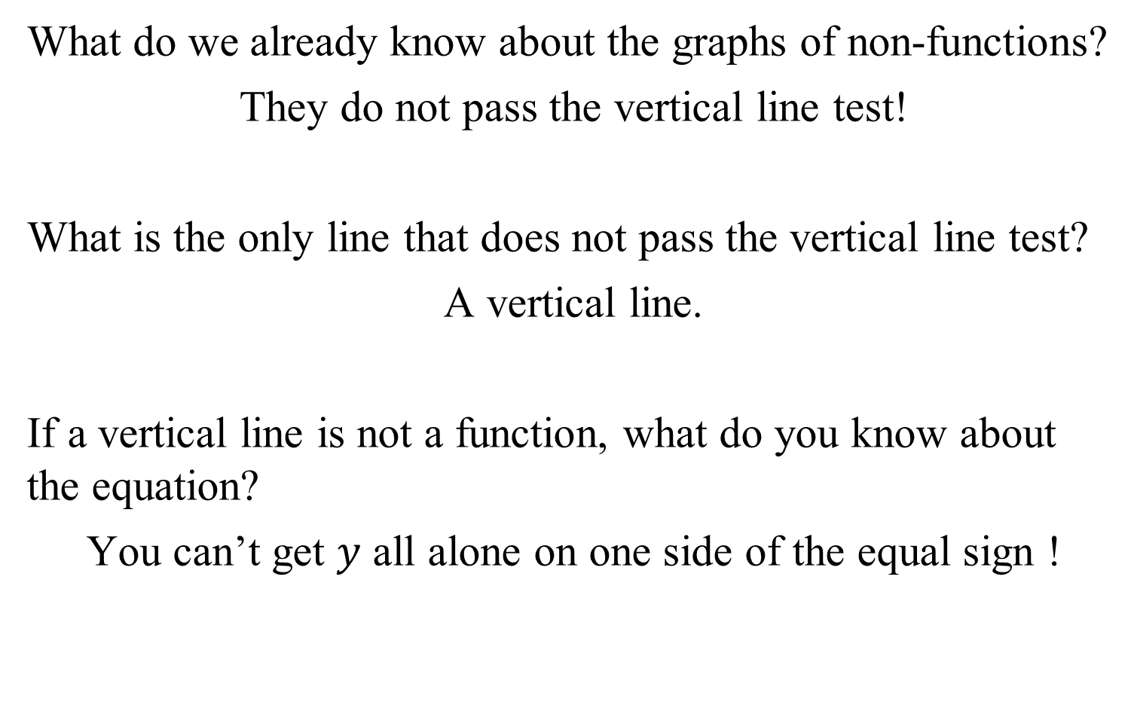
Linear Non-Functions
What do we already know about the graphs of non-functions?
They do not pass the vertical line test!
What is the only line that does not pass the vertical line test?
A vertical line.
If a vertical line is not a function, what do you know about the equation?
You can’t get $y$ all alone on one side of the equal sign !

Slide 11
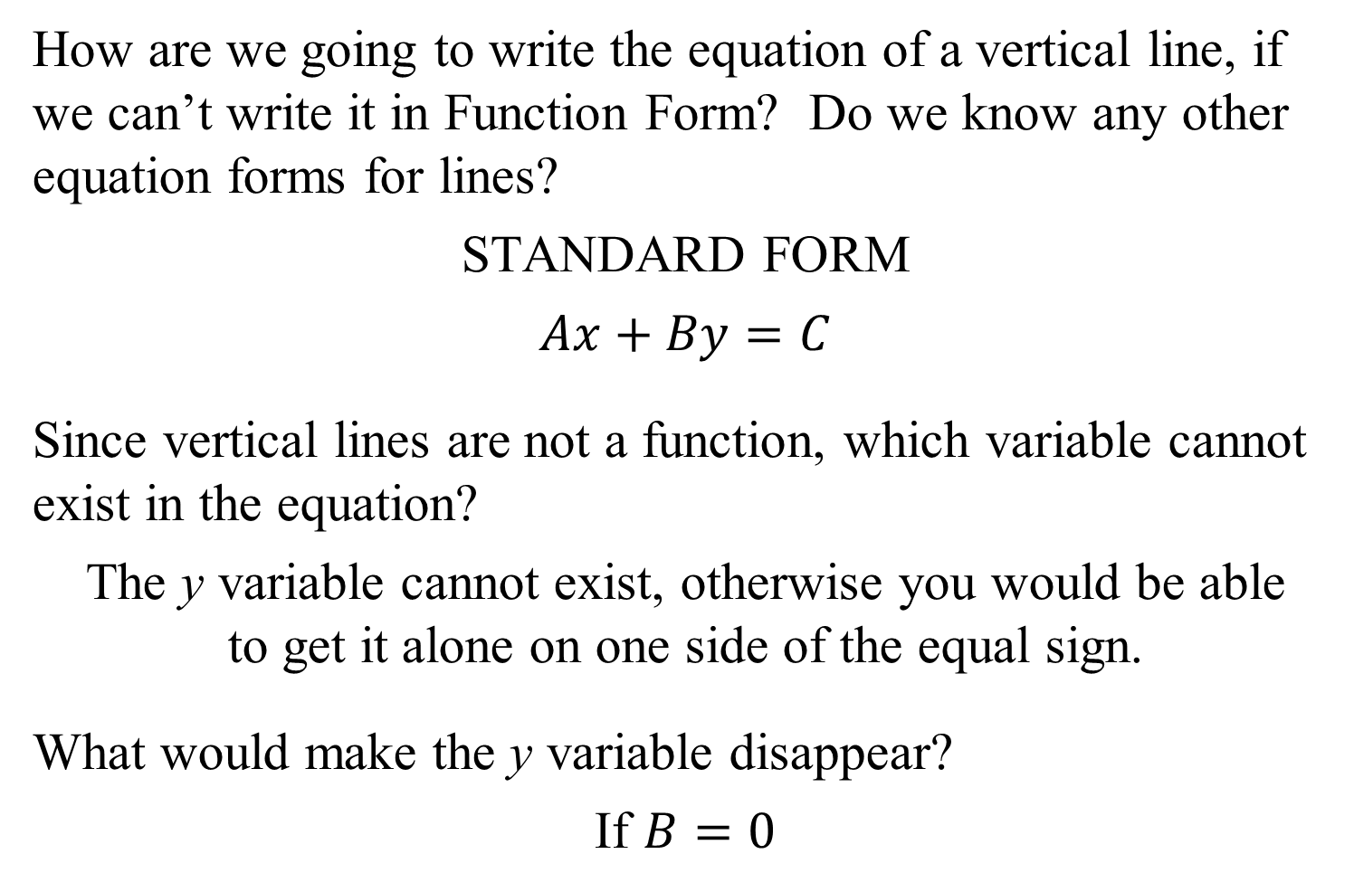
Linear Non-Functions
How are we going to write the equation of a vertical line, if we can’t write it in Function Form? Do we know any other equation forms for lines?
STANDARD FORM
$$Ax+By=C$$
Since vertical lines are not a function, which variable cannot exist in the equation?
The y variable cannot exist, otherwise you would be able to get it alone on one side of the equal sign.
What would make the y variable disappear?
If $B=0$

Slide 12
Linear Non-Functions
Let’s write an equation in STANDARD FORM with $B=0.$
$$Ax+By=C$$
$$Ax+0y=C$$
$$Ax=C$$
$$\frac{Ax}{A}=\frac{C}{A}$$
$$x=\frac{C}{A}$$
Since $\frac{C}{A}$ is a constant, we can write the equation as
$$x=a\text{ (}\text{where} \text{a} \text{is} \text{a} \text{constant}\text{)}$$

Slide 13
Constant Functions
We have just seen that a VERTICAL LINE takes the special form:
$x=a$ (where a is a constant)
What would the following lines look like on a graph?
$$x=4$$

Slide 14
$$x=−3$$

Slide 15
$$x=2.5$$

Slide 16
$$x=0$$
The equation $x=0$ is the equation for the
$$y−axis$$

