Slide 1
Finding Slope
F-IF: 1, 2, 5, 7, 9
A-REI: 10

Slide 2
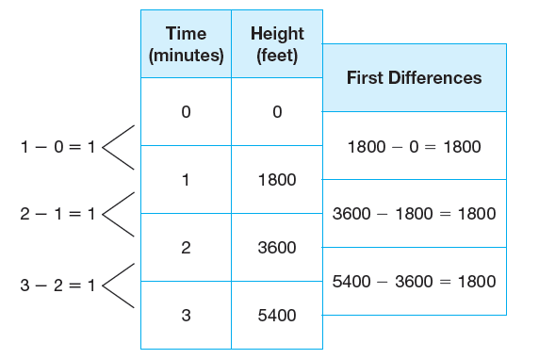
First Differences
First Differences
First differences are the values determined by subtracting consecutive y-values in a table when the x-values are consecutive integers.
Example:

Slide 3
SLOPE
Slope (pendiente):
The slope of a line is the ratio of the change in y-values (rise) to the corresponding change in x-values (run).
Slope uses the letter m.
$m=\frac{rise}{run}=\frac{y_{2}−y_{1}}{x_{2}−x_{1}}=\frac{Δy}{Δx}$ The Slope Formula

Slide 4
SLOPE FORMULA

Slide 5
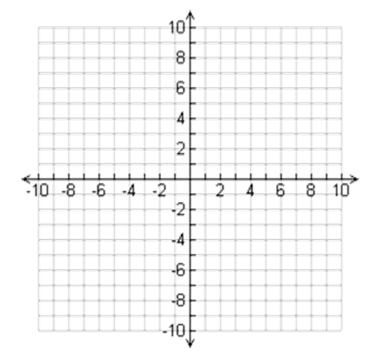
USING THE SLOPE FORMULA
Step 1:
Identify two points on the line.
(2,6) and (3,9)
Step 2:
LABEL each point
Point 1: (2,6)
(x₁, y₁)
Point 2: (3,9)
(x₂, y₂)
Step 3:
Write the slope formula
$$m=\frac{y_{2}−y_{1}}{x_{2}−x_{1}}$$
Step 4:
Substitute and solve (SIMPLIFY!)
$$m=\frac{9−6}{3−2}=\frac{3}{1}=3$$

Slide 6
Try These
Find the slope of the line between the two points:
(6,5) and (3,2)
(-7,5) and (2,-4)
(9,-7) and (-3,-7)
(4.3,8.5) and (3.1,-2.7)
(11,15) and (11,-2)

