Slide 1
Angle Theorems for Triangles
Essential Question?
What can you conclude about the measures of the angles of a triangle?
8.G.5

Slide 2
Common Core Standard:
8.G ─Understand congruence and similarity using physical models, transparencies, or geometry software.
5. Use informal arguments to establish facts about the angle sum and exterior angle of triangles, about the angles created when parallel lines are cut by a transversal, and the angle-angle criterion for similarity of triangles. For example, arrange three copies of the same triangle so that the sum of the three angles appears to form a line, and give an argument in terms of transversals why this is so.

Slide 3
Objectives:
To learn the basic angle theorems for triangles and use them to solve problems.

Slide 4
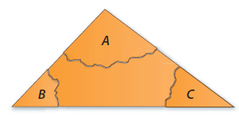
Sum of the Angle Measures in a Triangle
There is a special relationship between the measures of the interior angles of a triangle.
Using the cardstock you just received shade the inside corners and label the inside of each angle of the triangle.
Tear off each corner of the triangle.

Slide 5
Sum of the Angle Measures in a Triangle
Draw a point in your notebook. Rearrange the corners so that none of your corners overlap and there are no gaps between them.
What do you notice about how the angles fit together around a point?
How can you describe the relationship among the measures of the angles of a triangle?
Triangle Sum Theorem
For any $△ABC$
$m∠A+m∠B+m∠C=180°$
The sum of the measures of the interior angles of a triangle equals 180°

Slide 6
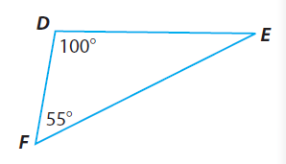
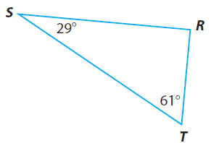
Using the Triangle Sum Theorem
Find the missing angle measure:
m∠E=
m∠K=
m∠R=

Slide 7
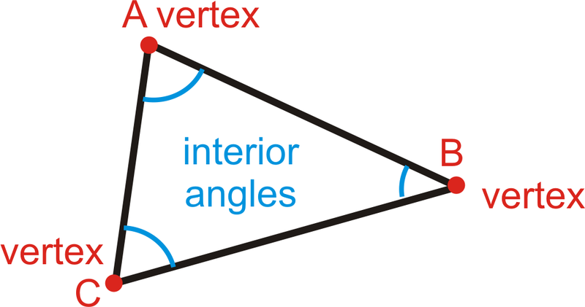
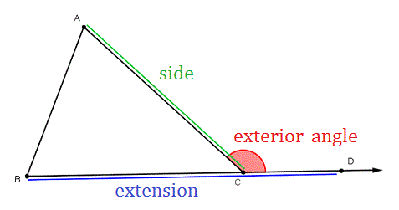
Exterior and Interior Angles
An INTERIOR ANGLE of a polygon is formed by two sides of the polygon and lies INSIDE the shape.
An EXTERIOR ANGLE is formed by one side of the polygon and the extension of an adjacent side.

Slide 8
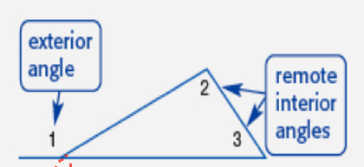
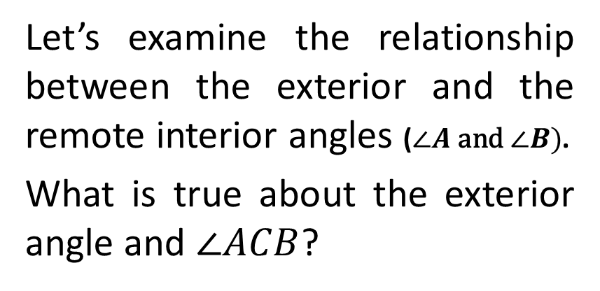
Exterior and Remote Interior Angles
A REMOTE INTERIOR ANGLE of a polygon is an interior angle that is not adjacent to the exterior angle.
Let’s examine the relationship between the exterior and the remote interior angles ($∠A \text{and} ∠B)$.
What is true about the exterior angle and $∠ACB$?
$∠$A
$$∠B$$
$$∠ACB$$
Since the exterior angle and $∠ACB$ are supplementary their sum is 180°.
Exterior angle $+∠ACB=180°$
The triangle sum theorem states that
$$∠A+∠B+∠ACB=180°$$

Slide 9
Exterior Angle Theorem
We now have two things equal to the same thing
Exterior angle $+∠ACB=180°$
$$∠A+∠B+∠ACB=180°$$
which means they must be
equal to each other
Exterior angle $+∠ACB =∠A+∠B+∠ACB$
$−∠ACB −∠ACB$
Exterior angle $=∠A+∠B$
Exterior Angle = Sum of the Remote Interior Angles

Slide 10
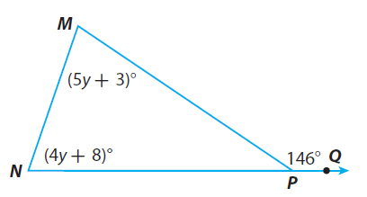
Using the Exterior Angle Theorem
Find all missing angle measures:
Angle | Measure
∠MNP
∠NMP
∠MPN

Slide 11
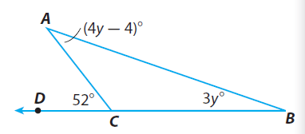
Using the Exterior Angle Theorem
Find all missing angle measures:
Angle | Measure
∠CAB
∠ABC
∠ACB

Slide 12
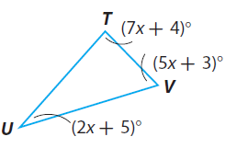
Find all missing angle measures:

Slide 13
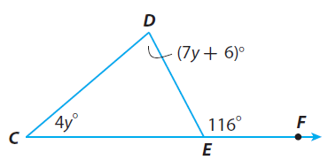
Find all missing angle measures:

Slide 14
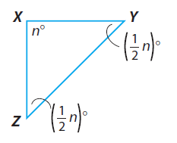
Find all missing angle measures:

Slide 15
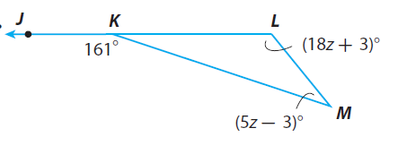
Find all missing angle measures:

Slide 16
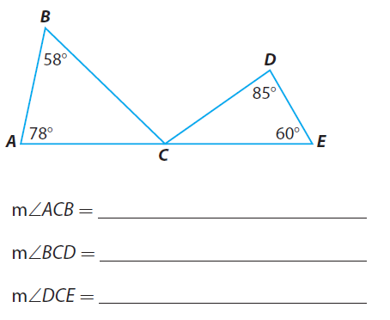
Find all missing angle measures:

Slide 17
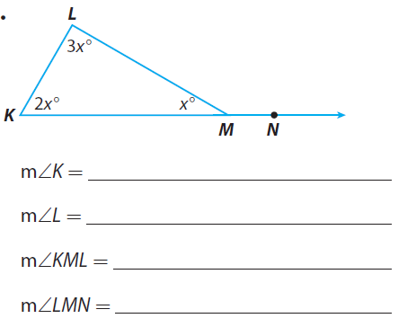
Find all missing angle measures:

