Slide 1
Describing & Comparing Functions
Essential Questions?
How can you tell if a function is linear?
How can you use multiple representations to compare functions?
8.F.2, 8.F.3

Slide 2
Common Core Standard:
8.F. ─ Define, evaluate, and compare functions.
2. Compare properties of two functions each represented in a different way (algebraically, graphically, numerically in tables, or by verbal descriptions). For example, given a linear function represented by a table of values and a linear function represented by an algebraic expression, determine which function has the greater rate of change.
3. Interpret the equation y = mx + b as defining a linear function, whose graph is a straight line; give examples of functions that are not linear. For example, the function A = s² giving the area of a square as a function of its side length is not linear because its graph contains the points (1,1), (2,4) and (3,9), which are not on a straight line.

Slide 3
Objectives:
To tell if a function is linear.
To compare & contrast functions represented either as a diagram, table of values, graph, or equation.

Slide 4
Curriculum Vocabulary
Linear Function (función lineal):
A function whose graph is a non-vertical straight line.

Slide 5
Determining LINEAR FUNCTIONS
You can determine if a function is linear in one of 3 ways:
TABLE
There is a constant rate of change
EQUATION
It can be written in the form
$$y=mx+b$$
GRAPH
It forms a non-vertical straight line

Slide 6
Determining LINEAR FUNCTIONS
Equation:
If the function is linear, it can be rewritten in slope-intercept form
Both the x and y variables have an invisible exponent of 1
Neither the x or y variable can be in the denominator of a fraction
$$\frac{1}{x}=x^{−1}$$

Slide 7
Determining LINEAR FUNCTIONS
Is this a linear function? Why?
$$5y+2=7x$$

Slide 8
Determining LINEAR FUNCTIONS
Is this a linear function? Why?
$$3−\frac{2}{3}x^{2}=4y$$

Slide 9
Determining LINEAR FUNCTIONS
Is this a linear function? Why?
$$−11y+\frac{4}{x}=6$$

Slide 10
Determining LINEAR FUNCTIONS
Is this a linear function? Why?
$$4x−3=17x+2$$
But is it linear?
YES
An equation in the form $$x=a constant$$
is a VERTICAL LINE.
Examples: $x=7$ $x=−3$
$x=\frac{2}{3}$ $x=11.2$

Slide 11
Determining LINEAR FUNCTIONS
Graph:
If the function is linear, graphs to be a NON-VERTICAL line.
Remember that a vertical line doesn’t pass the vertical line test!

Slide 12
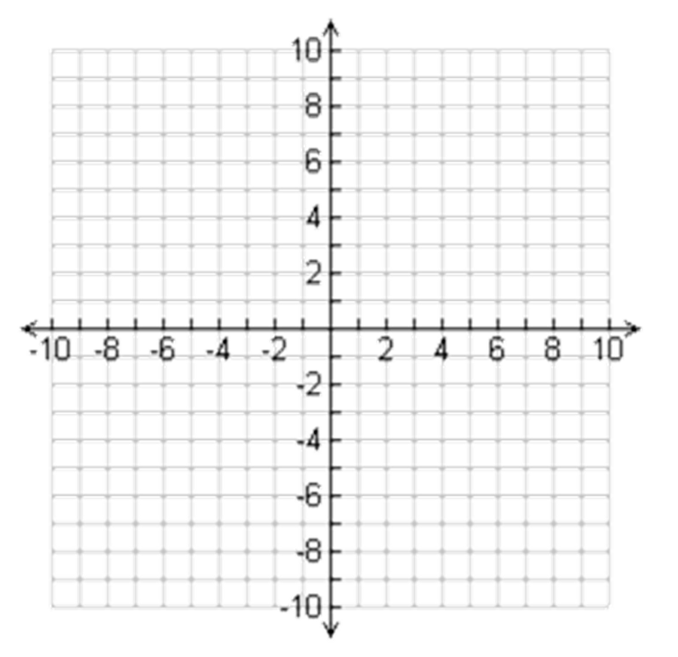
Determining LINEAR FUNCTIONS
Is this a linear function? Why?

Slide 13
Determining LINEAR FUNCTIONS
Is this a linear function? Why?

Slide 14
Determining LINEAR FUNCTIONS
Is this a linear function? Why?

Slide 15
Determining LINEAR FUNCTIONS
Is this a linear function? Why?

Slide 16
Determining LINEAR FUNCTIONS
Is this a linear function? Why?

Slide 17
Determining LINEAR FUNCTIONS
Is this a linear function? Why?

Slide 18
Determining LINEAR FUNCTIONS
Table:
If the table shows a CONSTANT RATE OF CHANGE, the function is linear.

Slide 19
Determining LINEAR FUNCTIONS
Is this a linear function? Why?
INPUT | OUTPUT
1 | ─ 1
2 | 1
5 | 7
7 | 11
15 | 27

Slide 20
Determining LINEAR FUNCTIONS
Is this a linear function? Why?
INPUT | -3 | -1 | 0 | 5
OUTPUT | -10 | -8 | -7 | -2

Slide 21
Determining LINEAR FUNCTIONS
Is this a linear function? Why?
INPUT | OUTPUT
1 | 5
2 | 7
3 | 10
4 | 12
5 | 15

Slide 22
Determining LINEAR FUNCTIONS
Is this a linear function? Why?
INPUT | -5 | -3 | 0 | 2
OUTPUT | 6 | 9 | 12 | 15

Slide 23
Determining LINEAR FUNCTIONS
Is this a linear function? Why?
INPUT | OUTPUT
-5 | -125
-3 | -27
0 | 0
1 | 1
2 | 8

Slide 24
COMPARING LINEAR FUNCTIONS
To compare linear functions it is best to first turn them into equations in SLOPE-INTERCEPT form. Then you can compare the slopes and y-intercept.
Example: Gold’s Gym charges $60 to join plus $15 per month. The table shows the cost to belong to World Gym.
Month | 2 | 5 | 7 | 11
Total Cost: | 80 | 125 | 155 | 215
Which gym is more expensive? What does the slope of the line tell us? What does the y-intercept tell us?
Will this always be true?

Slide 25
COMPARING LINEAR FUNCTIONS
Graph both gyms on the same piece of graph paper to compare.
GOLD’S GYM
$$y=15x+60$$
WORLD GYM
$$y=15x+50$$
Looking at the graph, what statements can you make about the lines?
What appears to be true?
150
140
130
120
110
100
90
80
70
60
50
40
30
20
10
0
PARALLEL LINES have the SAME SLOPE but DIFFERENT y-INTERCEPTS.
Total Cost ($)
0 1 2 3 4 5 6 7 8 9 10 11 12 13 14 15
Number of Months

Slide 26
COMPARING LINEAR FUNCTIONS
Example:
Batman & Robin are trying to save Gotham from The Riddler. Batman started on the ground and is climbing a rope at a rate of 1 foot every three seconds. At the same time Robin swings out of a window 40 feet above the ground and starts descending on his rope at a rate of 3 feet per second.
Will the lines governing The Caped Crusader’s & The Boy Wonder’s movement intersect? What does the slope of each line tell us? What does the y-intercept tell us?

Slide 27
COMPARING LINEAR FUNCTIONS
Graph both gyms on the same piece of graph paper to compare.
Batman
$$y=\frac{1}{3}x$$
Robin
$$y=−3x+40$$
Looking at the graph, what statements can you make about the lines?
What appears to be true?
75
70
65
60
55
50
45
40
35
30
25
20
15
10
5
0
PERPENDICULAR LINES have OPPOSITE RECIPROCAL SLOPES.
Height Above the Ground (Feet)
0 5 10 15 20 25 30 35 40 45 50 55 60 65 70 75
TIME (seconds)

Slide 28
PERPENDICULAR LINES
VISIT
http://stevensonalgebra.weebly.com/algebra-songs.html
for my video

Slide 29
COMPARING LINEAR FUNCTIONS
If lines have different slopes they
MUST INTERSECT
somewhere in space!

