Slide 1
LITERAL EQUATIONS
PRE-REQUISITE

Slide 2
Curriculum Vocabulary
Literal Equation (ecuación literal):
A literal equation is an equation with two or more variables.
Example: $y=5x−4$
A formula is a type of literal equation.
To solve for one of the variables, use inverse operations.

Slide 3
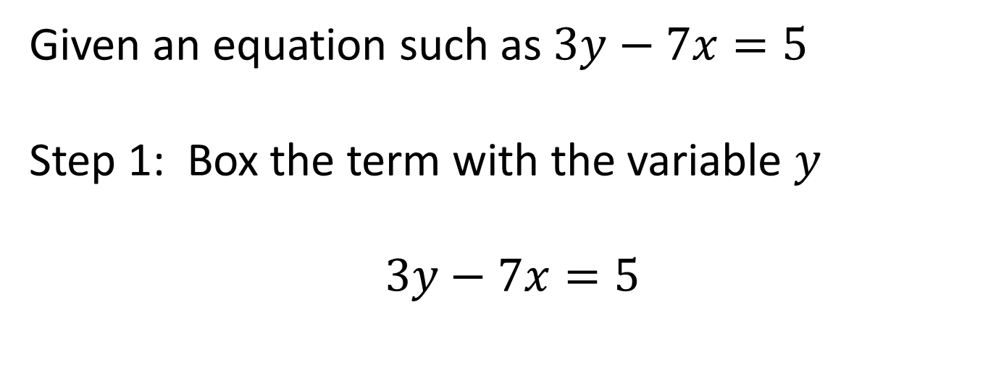
Re-writing an Equation in Slope-Intercept Form
Given an equation such as $3y−7x=5$
Step 1: Box the term with the variable $y$
$3y−7x=5$

Slide 4
Re-writing an Equation in Slope-Intercept Form
Step 2: Use INVERSE OPERATIONS (OPPOSITES) to move everything outside the box away from the box.
$3y−7x=5$
$+7x=+7x$
$3y=7x+5$

Slide 5
Re-writing an Equation in Slope-Intercept Form
Step 3: Use INVERSE OPERATIONS (RECIPROCALS) to move the coefficient away from y.
Distribute the denominator (separate the happy family with love).
$3y=7x+5$
$\frac{3y}{3}=\frac{7x+5 }{3}$
$$y=\frac{7}{3}x+\frac{5}{3}$$

